Slide 1
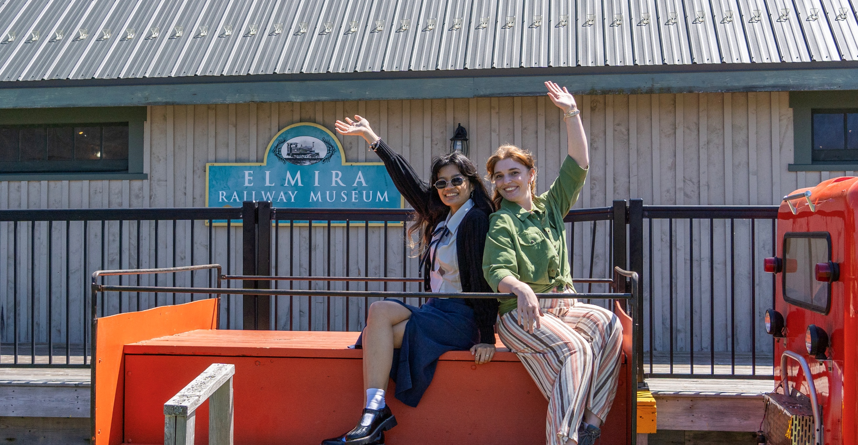
WELCOME!
PEI Museum and Heritage Foundation

Slide 2

Operating 7 provincial museums and heritage sites across PEI
Preserving the provincial collection of more than 100,000 objects and cultural materials
Our goals:
Study, collect, preserve, interpret and protect the history of PEI
Acquire and share knowledge of Island history, culture, and its natural world
Encourage Island residents and visitors to explore, discover, appreciate, and understand PEI history and heritage
ABOUT US
Notes:
Why don’t you use “Artifact” anymore? Mostly because it is a move towards more inclusive language. We still do use artefact sometimes but it gives off very clinical colonial biases vibes. Artifacts sound like a culture is only historical and not a living breathing present culture. It is particularly important when talking about indigenous communities.

Slide 3
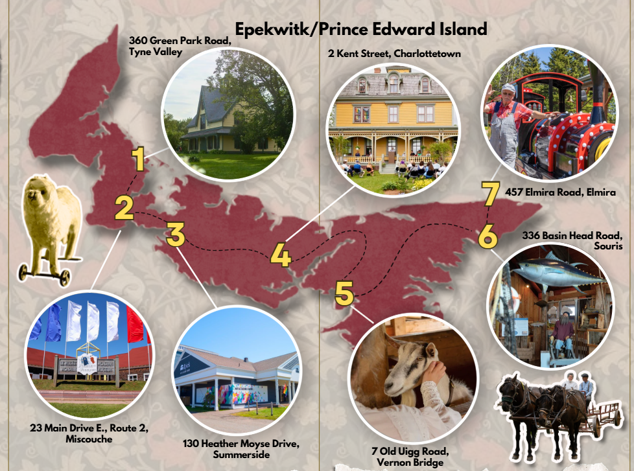

Slide 4
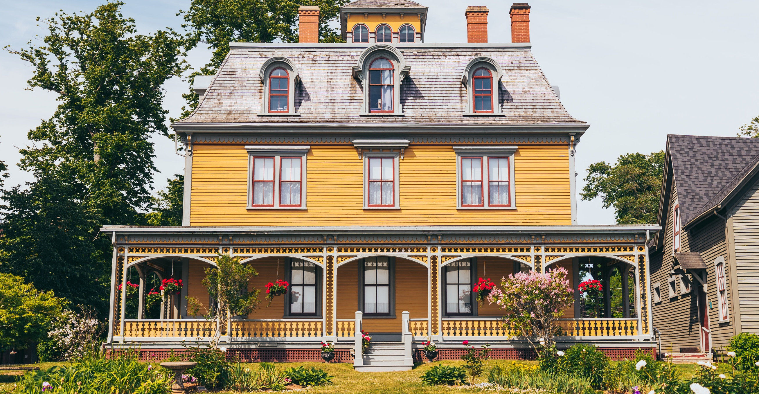
BEACONSFIELD
HISTORIC HOUSE
2 Kent Street, Charlottetown

Slide 5
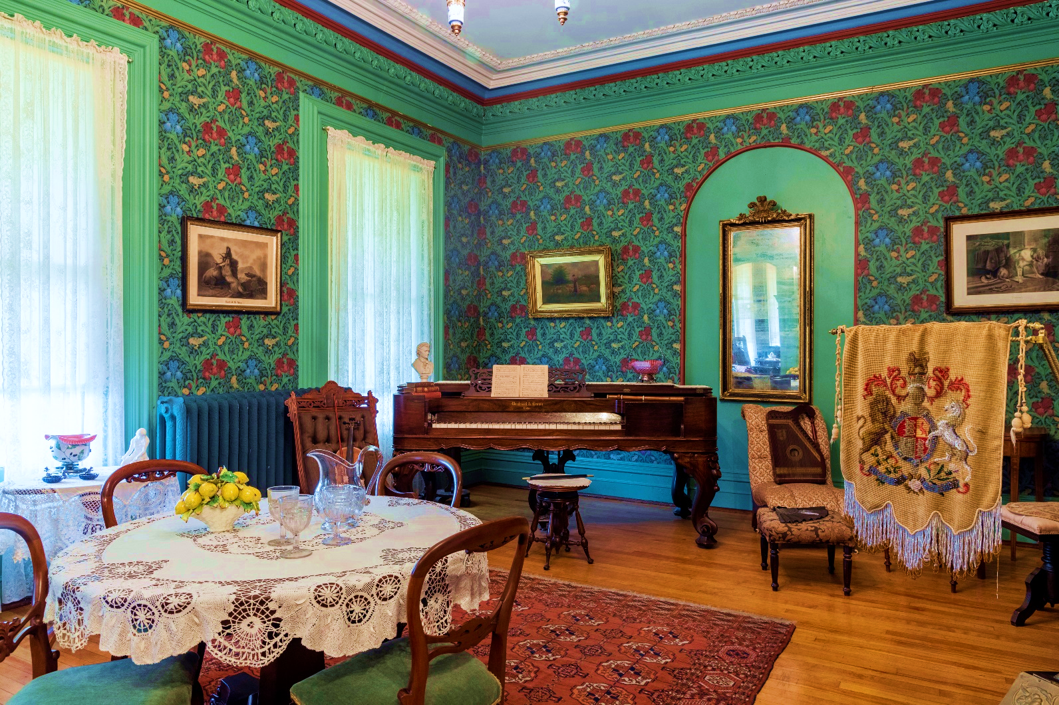
HIGHLIGHTS
Designed and built by W.C. Harris in 1877
Opening hours:
  Tuesday to Friday – 11:00 am to 3:00 pm
Did you know? Beaconsfield is our only site that exclusively offers guided tours. The tour takes approximately 30-40 minutes.
American Sign Language Interpreted Tours & Other Tours
The Bog Tour
The Carriage House
A beautiful example of Victorian architecture with many original features and fascinating stories to tell!
Notes:
Overview of Beaconsfield (5 minutes):
Designed and built by W.C. Harris in 1877 for James and Edith Peake, Beaconsfield was one of Charlottetown’s most elegant homes. Featuring the finest materials and craftsmanship, it was also equipped with all the latest conveniences of the day. The Peakes, unfortunately, were destined to enjoy Beaconsfield for a very short time - a time filled with triumphs and tragedies.
Henry Cundall, the second owner, moved into Beaconsfield in 1883 with his sisters Penelope and Millicent. After his death in 1916, the house was used as a young ladies’ residence, and later, the “Cundall Home” became a residence for student nurses.
Today, Beaconsfield Historic House stands as a beautiful example of Victorian architecture with many original features and a fascinating story! It's open year-round for tours and hosts lectures, concerts, and other special events in the Carriage House. Visit our gift shop featuring locally made gifts, Island books, magazines, pottery and more!
W.C. Harris is one of, if not the most famous, early architects of PEI. It’s his birthday on April 30! He’d be 172 this year.

Slide 6
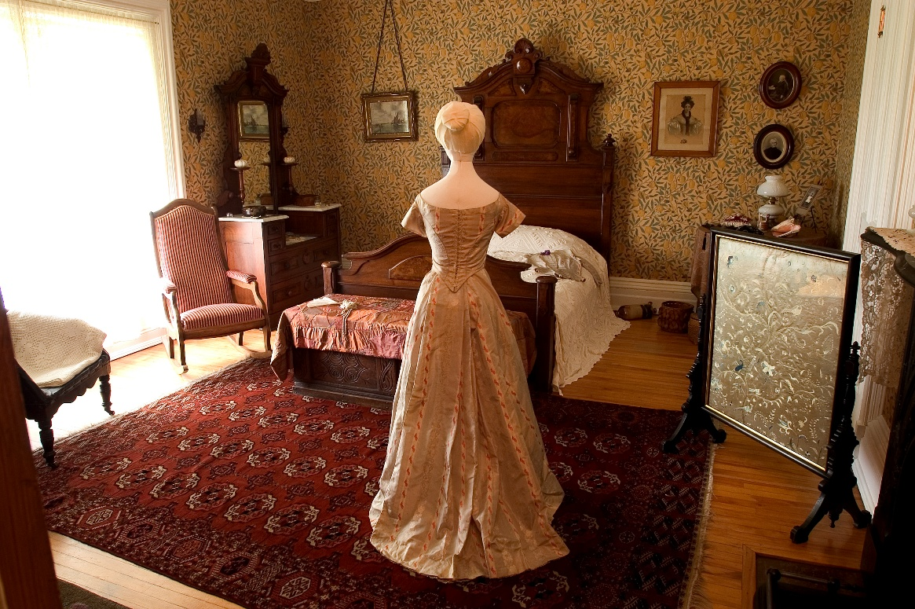
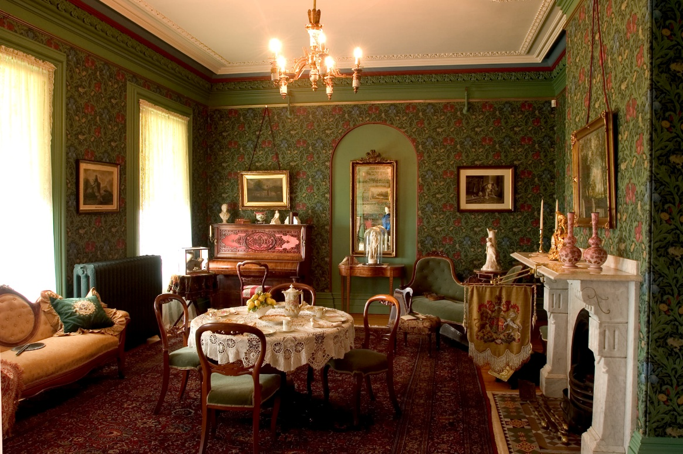
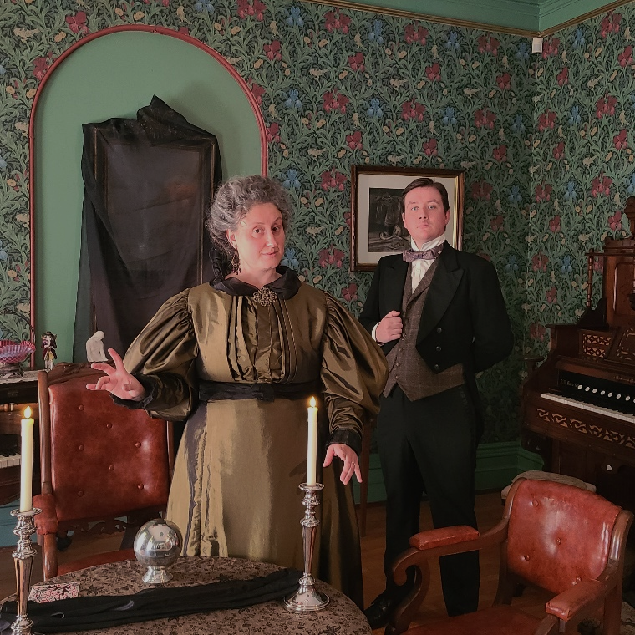
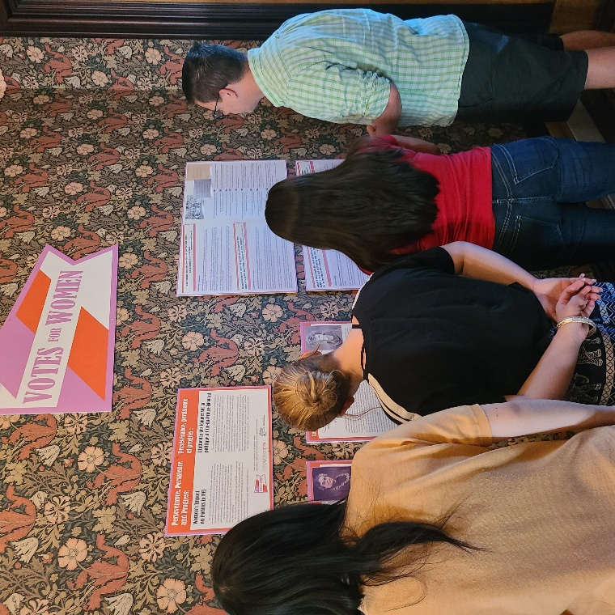
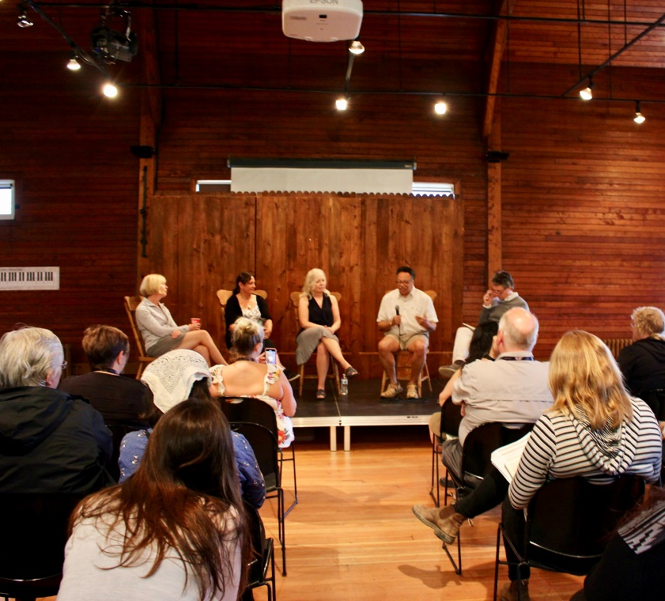
Notes:
Beaconsfield is our only site that exclusively offers guided tours due to the fragile and delicate nature of the home and the objects therein.
In April 2026, we piloted an American Sign Language (ASL) Interpreted House Tour in collaboration with the Canadian Cultural Society of the Deaf. We plan to bring these tours back as a regular feature in the future.
In the warmer months, Beaconsfield hosts The Bog Tour, which takes guests on a guided tour throughout what used to be the historic Bog neighbourhood, in the area where the Provincial Administration Buildings now stand, and surrounding areas, was a thriving community of diverse peoples. Take the tour and learn more!
We often do special seasonal tours like our Victorian Christmas tour in December, Beaconsfield by Candlelight around Halloween, and our programming lead is cooking up something with a little more mystery and thrill for this fall! Any true crime enjoyers in the house? Stay tuned to our socials this Fall.
Finally, the Carriage House is host to a plethora of community events from business meetings to yoga classes to amateur comedy to music concerts, drag shows, and beyond! Check it out sometime. Chances are, there’s an event for you happening there. Most of the CH events are external, third-party events that we provide a venue for, just to clarify.

Slide 7
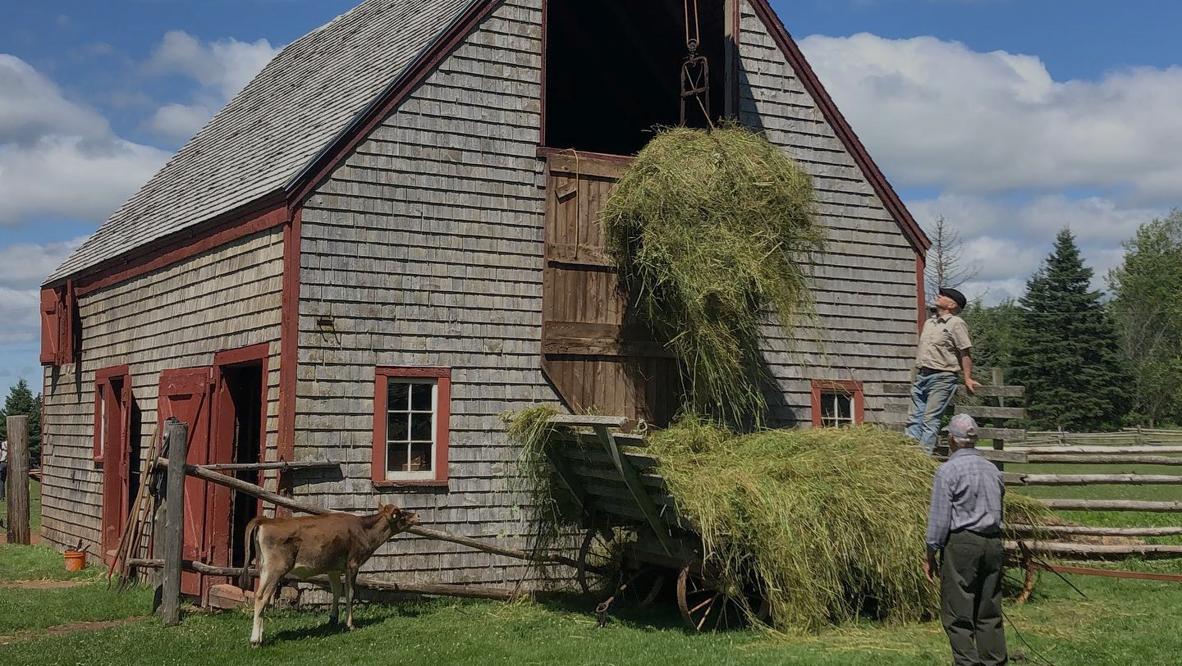
VISIT OUR OTHER SITES!

Slide 8
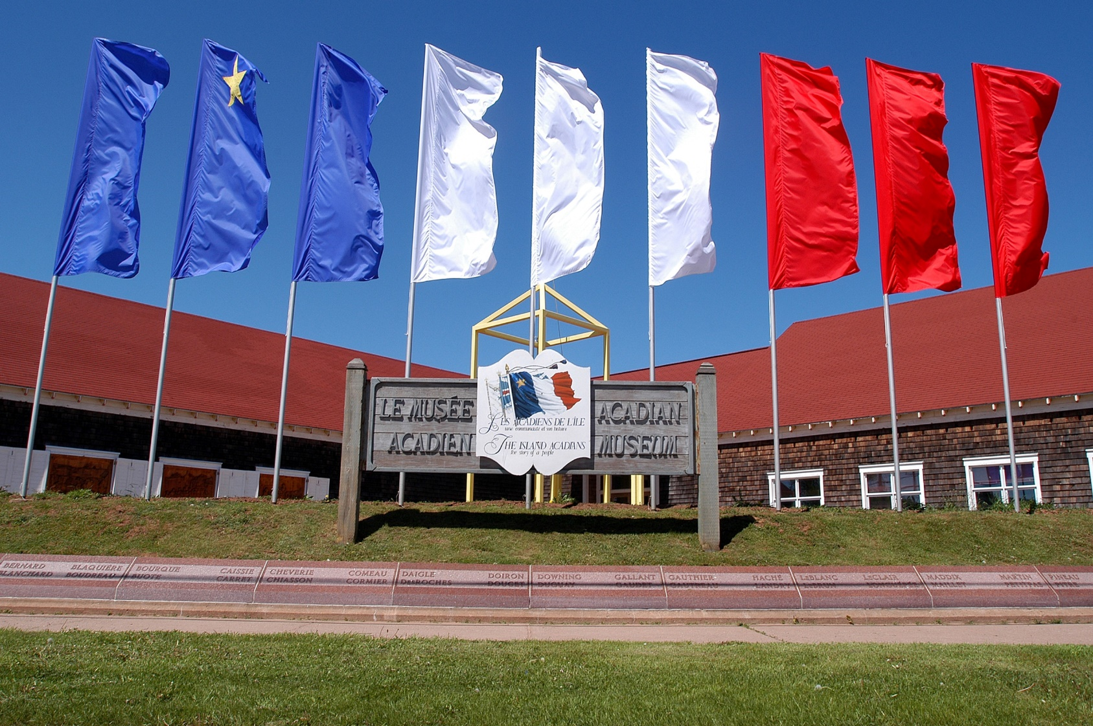
ACADIAN MUSEUM of PEI
Location:
Route 2, Miscouche
(west of Summerside)
Summer Hours:
June 1 to June 30
Monday – Friday: 10:00 am - 5:00 pm
July 1 to August 29
Monday – Saturday: 10:00 am - 5:00 pm
Fall, Winter and Spring:
September 2 to June 1
Tuesday to Friday: 10:00 am - 5:00 pm
Notes:
Open year-round! Follow the fascinating odyssey of Island Acadians from 1720 to the present day. Discover treasures related to the Acadians’ 300-year presence on Prince Edward Island. View videos and historical paintings. Our permanent and changing exhibitions showcase the multifaceted aspects of Acadian history and culture.
Research your Acadian family roots through the onsite genealogy resources and shop for locally made products and books in our gift shop.
Often hosts and participants in Acadian events such as the Acadian Day of Remembrance.

Slide 9
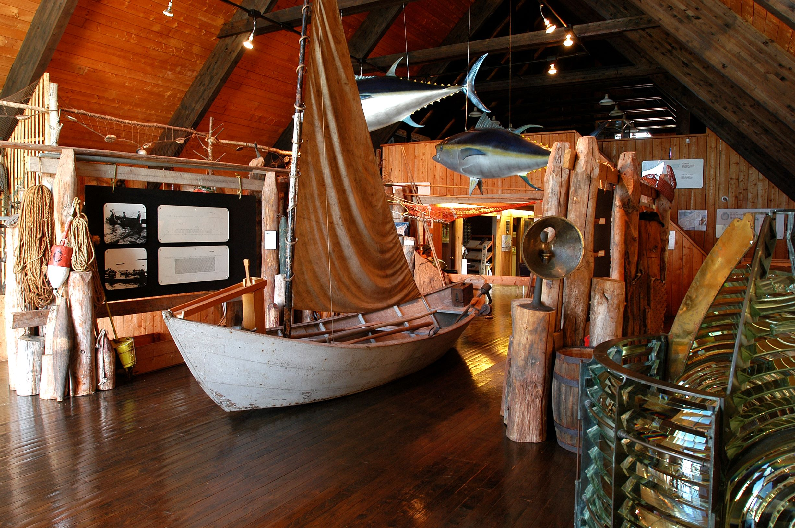
BASIN HEAD FISHERIES MUSEUM
Location:
336 Basin Head Road, Souris
Operating hours:
June 1 to June 30
Monday – Friday: 9:30 am - 5:00 pm
July and August
Daily 9:30 am - 5:00 pm
September
Thursday – Monday: 9:30 am - 5:00 pm
Notes:
Overlooking the beautiful Northumberland Strait, Basin Head Fisheries Museum tells the story of the Island’s fishery with displays and exhibits that will take you back in time. Visit the historic Cannery for a glimpse at what the fishing industry really looked like!
There is much to do while at Basin Head. Wander the boardwalk and stroll along the magnificent white “singing” sands. Discover Sun, Sand and Surf, the museum's large gift shop stocked with local crafts and beach essentials. Also on-site is The Scoop for ice cream treats, cold drinks, and a children's play village!

Slide 10
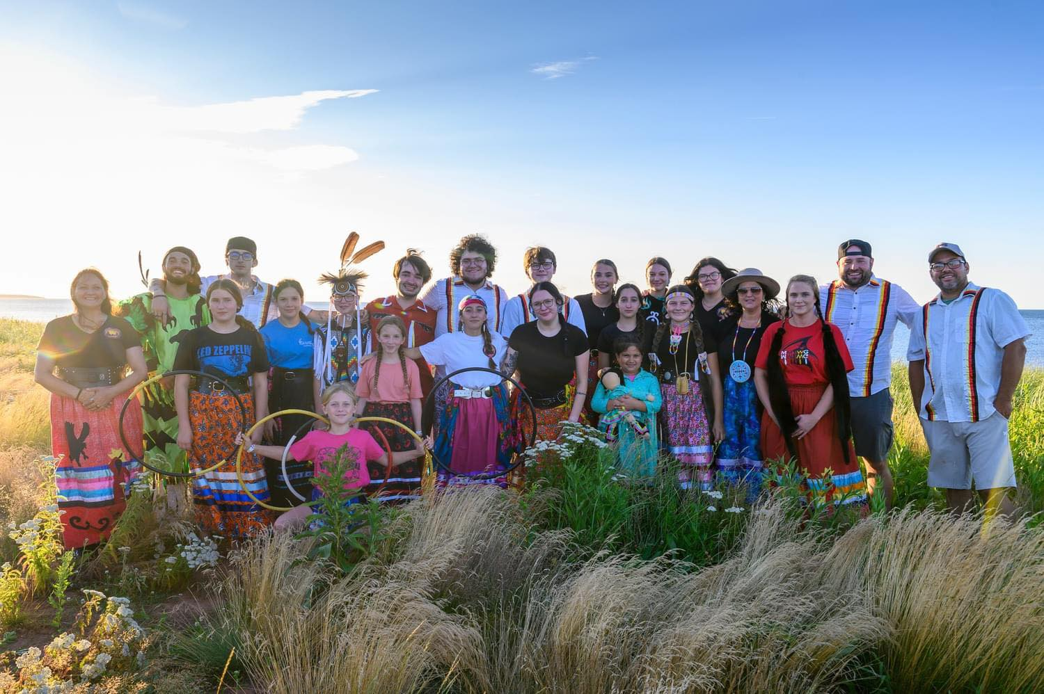
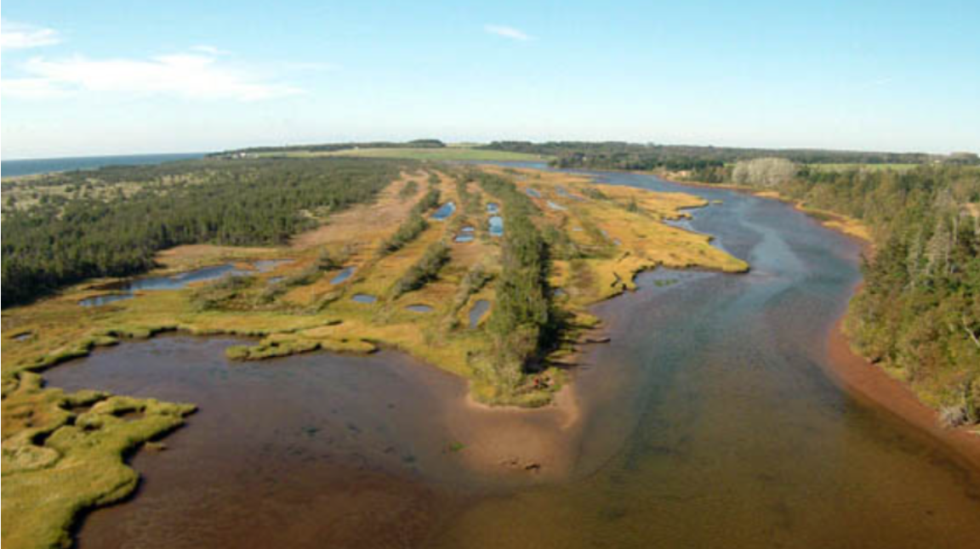
BASIN HEAD FISHERIES MUSEUM
Mi’Kmaq Heritage Actors
Marine Protected Area Tour
Join the Mi'kmaq Heritage Actors for a weekly hour of storytelling with songs, drumming, and dance.
This show happens rain or shine and will take place inside the museum if the weather calls for it. Summer 2026 dates TBD – stay tuned to our socials.
This 1-hour tour provides an immersive experience for visitors to:
Learn local history
Experience the singing sands beneath their feet
Have a tasty treat (ice cream)
Take part in the conservation effort by pulling a Green Crab trap and documenting the contents!
Notes:
Check out our Marine Protected Area Tour, created in collaboration with Department of Fisheries and Oceans and with local Indigenous Elders and community members! This one-hour tour provides an immersive experience where visitors will learn about the Marine Protected Area and local history that connects this place to the province’s human and natural heritage. Participants will also get to experience the singing sands beneath their feet, have a tasty treat (ice cream) that contains carrageenan from Irish Moss that is similar to the Irish Moss that grows in the Basin Head lagoon, and to take part in the conservation effort by pulling a Green Crab trap and documenting the contents!

Slide 11
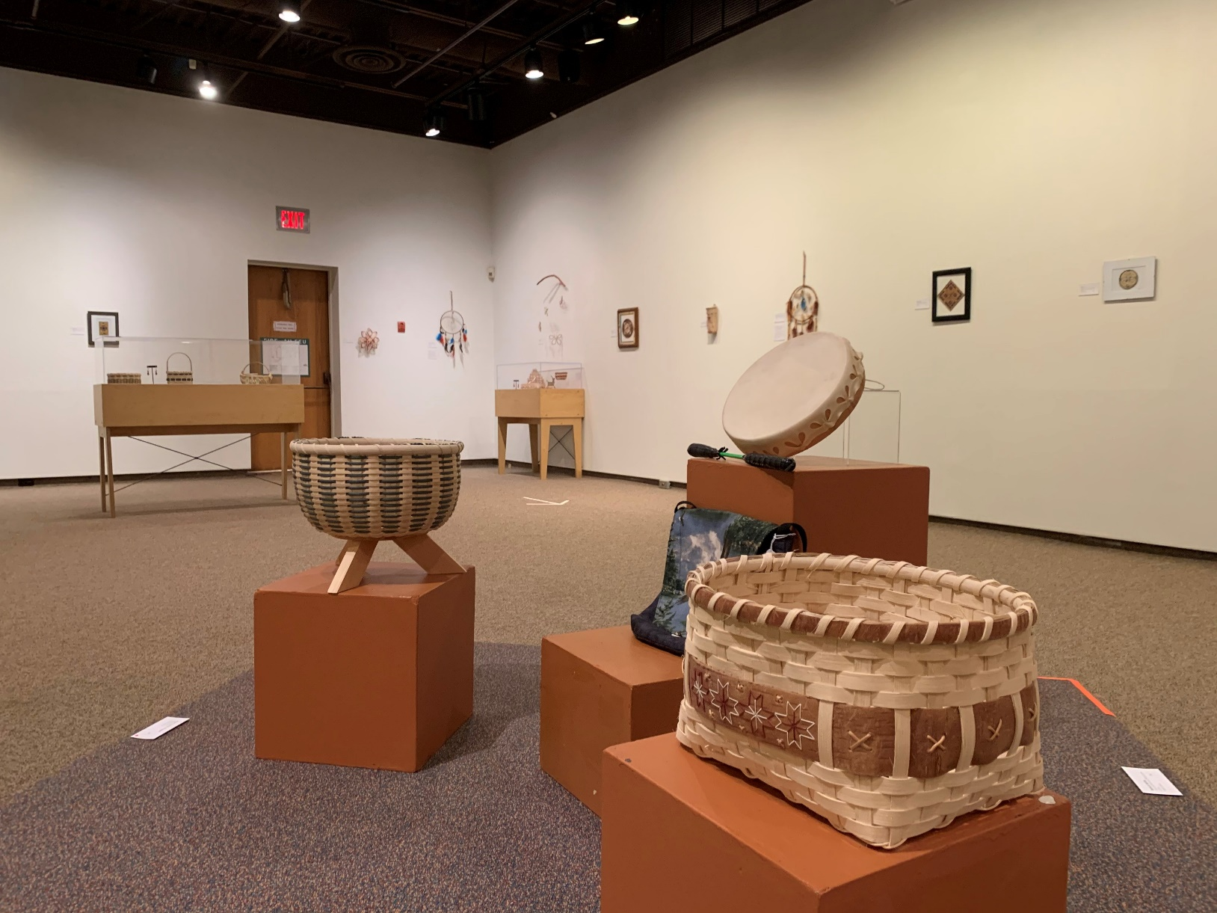
EPTEK ART & CULTURE CENTER
Location:
130 Heather Moyse Drive, Summerside
Operating hours:
October 1 to June 30
Tuesday to Friday 10:00 am - 4:00 pm
Sunday 12:00 pm - 4:00 pm
July, August, September
Tuesday to Saturday 9:00 am -5:00 pm
Sunday 12:00 pm - 5:00 pm
Notes:
Eptek Art & Culture Centre is our most modern site and is closest to an art gallery. It is an exhibition facility that offers frequently-changing exhibits, a variety of programming, and a gift shop featuring a wide selection of Island-made fine art and craft, and books on Island themes. Exhibits and programming highlight visual art, craft, history, culture, and science.
Open year-round, Eptek offers weekday art and craft demonstrations in the summer months. In the winter months, Eptek Centre becomes a community hub with many events: exhibit openings, a weekly film series, monthly book club meetings, lectures, book launches, demonstrations, and other special events.
Check our website peimuseum.ca and our socials, and Eptek’s socials, for frequent updates about the goings on. It’s a happening place!
This summer, visit Eptek and view our upcoming Foundation Exhibition titled “Women’s Work”

Slide 12
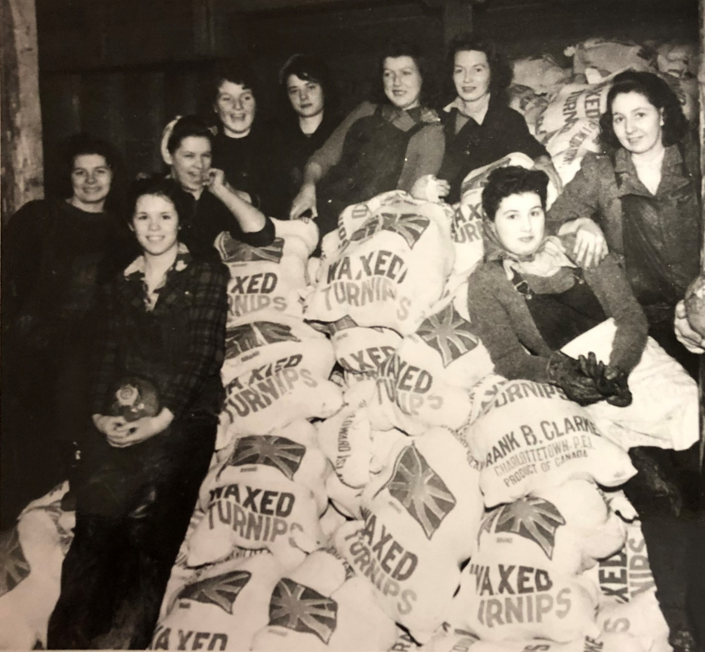
EPTEK ART & CULTURE CENTER
UPCOMING EXHIBIT
Women’s Work: Doing what needs to be done
This summer, we are pleased to offer Women’s Work: Doing what needs to be done, hosted by Eptek Art & Culture Centre one of our seven sites.
This exhibition, developed by the PEI Museum & Heritage Foundation and offered as part of our Summer Season 2026, will examine the term women’s work and the role it plays within PEI history.
In the words of Katherine Dewar, a prolific Island historian who recently passed away: “So glad someone is interested in women.”
Notes:
Women’s Work : Doing what needs to be done
This summer, we are pleased to offer Women’s Work, hosted by Eptek Art & Culture Centre one of our seven sites. This exhibition, developed by the PEI Museum & Heritage Foundation and offered as part of our Summer Season 2026, will examine the term women’s work and the role it plays within PEI history.
Inspiration for this exhibition came from the amazing belongings that we are privileged to hold in trust as part of the provincial artefact collection. Women, for thousands of years, have contributed their labour to ensure the success of their families and communities on this land. We will glimpse into how these efforts affected PEI’s big industries, what activities are considered acceptable pastimes for ladies, and where we might focus future efforts. While we can only scratch the surface, we are excited to have the opportunity to showcase stories of Island women alongside a small selection of the provincial collection.
In the words of Katherine Dewar, a prolific Island historian who recently passed away: So glad someone is interested in women.

Slide 13
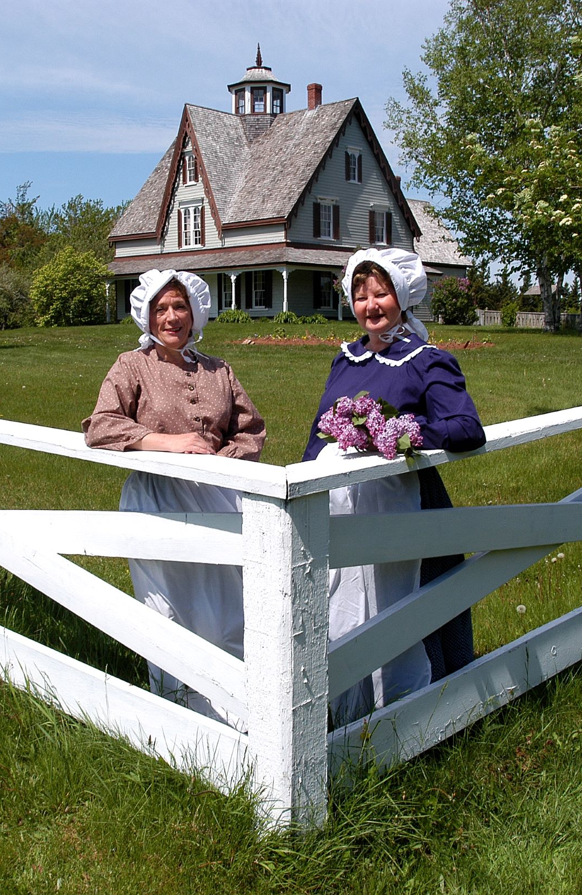
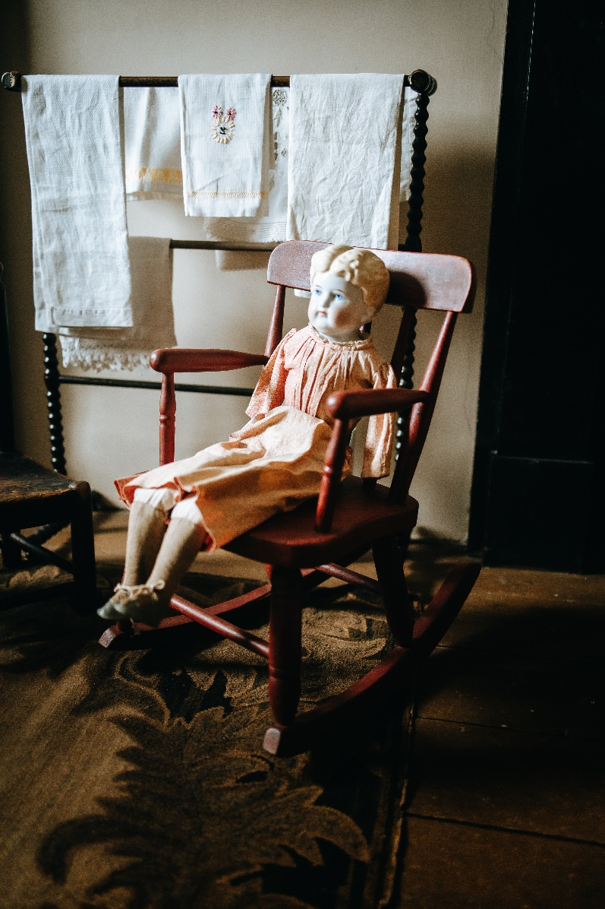

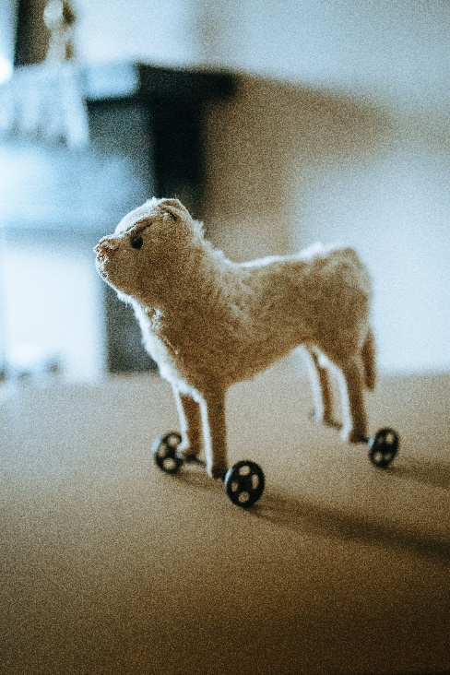
GREENPARK SHIPBUILDING MUSEUM
& YEO HOUSE
Location:
360 Green Park Road,
Tyne Valley
Operating hours:
June
Monday to Saturday:
10:00 am - 4:00 pm
July 1 to August 29
Monday to Saturday:
10:00 am - 4:30 pm
Join us for the annual Blueberry Social on Saturday, August 15!
Notes:
Travel back in time to the 1860s at Green Park Shipbuilding Museum and Historic Yeo House!
Visit the Green Park Shipbuilding Museum to experience the Island's 1860s shipbuilding industry. Then take a Haunted Tour over at Historic Yeo House, a beautifully restored Victorian Home. Take a respectful gander at our unofficial haunted mascot Wheelie, and see if you feel any cold spots or hear any unexplained footsteps.
Visitors are also invited to view the historic schoolhouse and try their hand at blacksmithing. Have a picnic or a walk around the gardens before you head out.
In August, usually the 2nd Saturday of the month, join us for our annual Blueberry Social featuring delicious homemade blueberry pies and ice-cream, live music, 50/50 prize draw, and family-friendly activities. Admission is free!

Slide 14
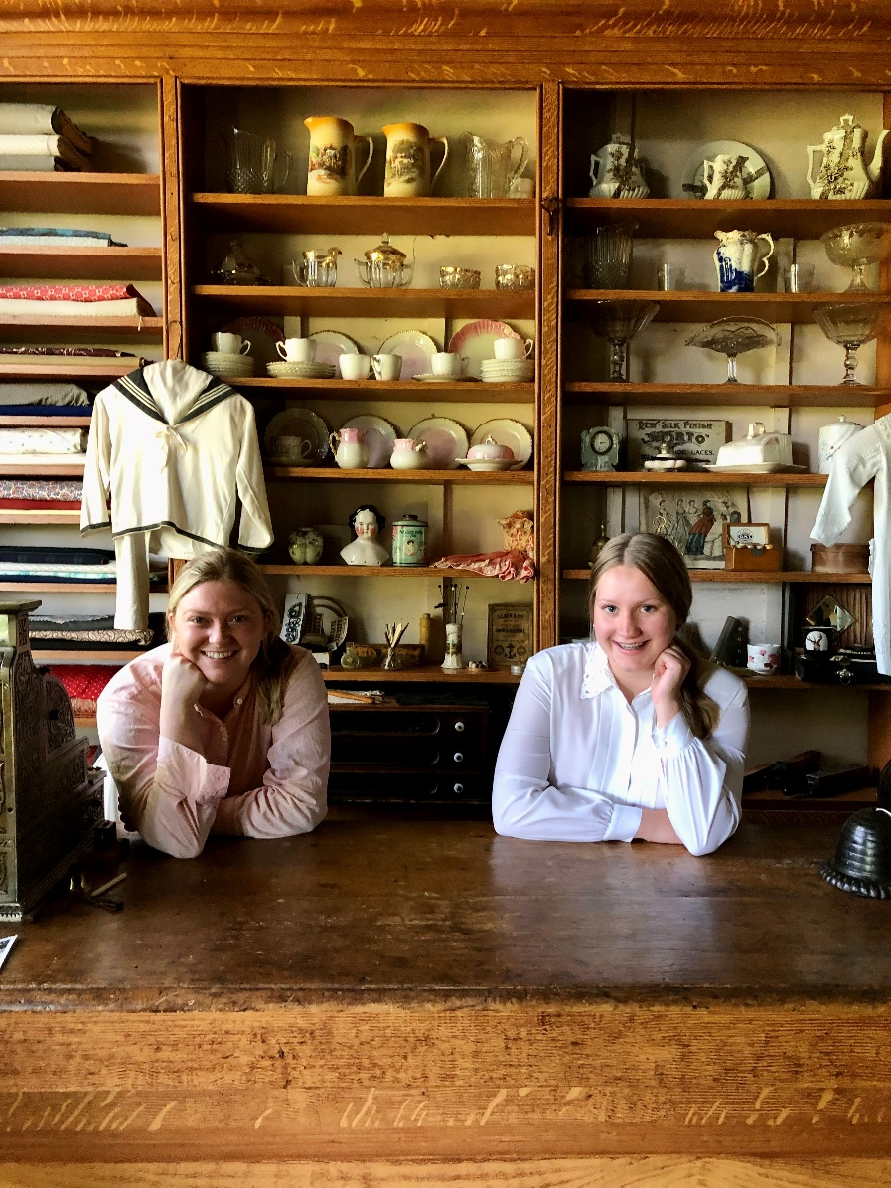
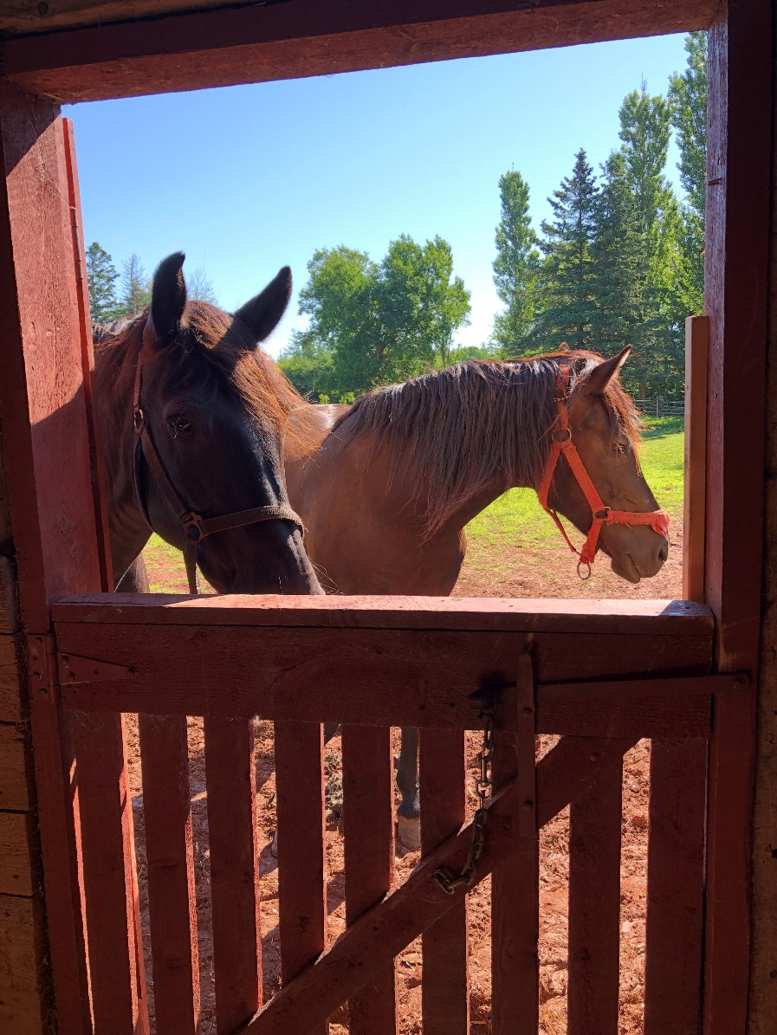
ORWELL CORNER HISTORIC VILLAGE
Location:
7 Old Uigg Road,
Vernon Bridge
Operating hours:
May & June
Monday to Friday: 8:30 am - 4:30 pm
July and August
Daily 8:30 am - 4:30 pm
September & October
Monday to Friday: 8:30 am - 4:30 pm
Notes:
A charming historic village that depicts life in PEI in the 1890s and engage in fun, family-friendly activities. Visitors can feed the farm animals, explore the Agricultural Museum, try their hand at blacksmithing with our Forge on the Farm Blacksmith Experience, go for a horse and wagon ride, and visit the general store, church, and schoolhouse.
Engage in daily programming specially designed to keep children happy while also learning and having fun. Stroll through the beautiful gardens, have a picnic by a scenic look-off to the beautiful Orwell Bay, or enjoy a homemade lunch in the Tea Room at the Community Hall.
If you haven’t been to Orwell, you should fix that. It rocks. And it’s right by beautiful MacPhail Woods, no affiliation I just love the trail and the old growth forest. Great weekend trip up there is an Orwell visit and then a trail walk.

Slide 15
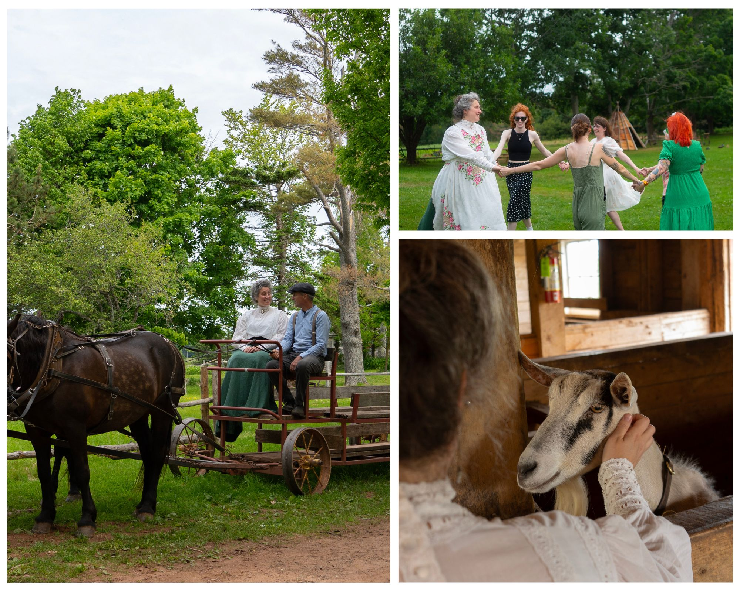
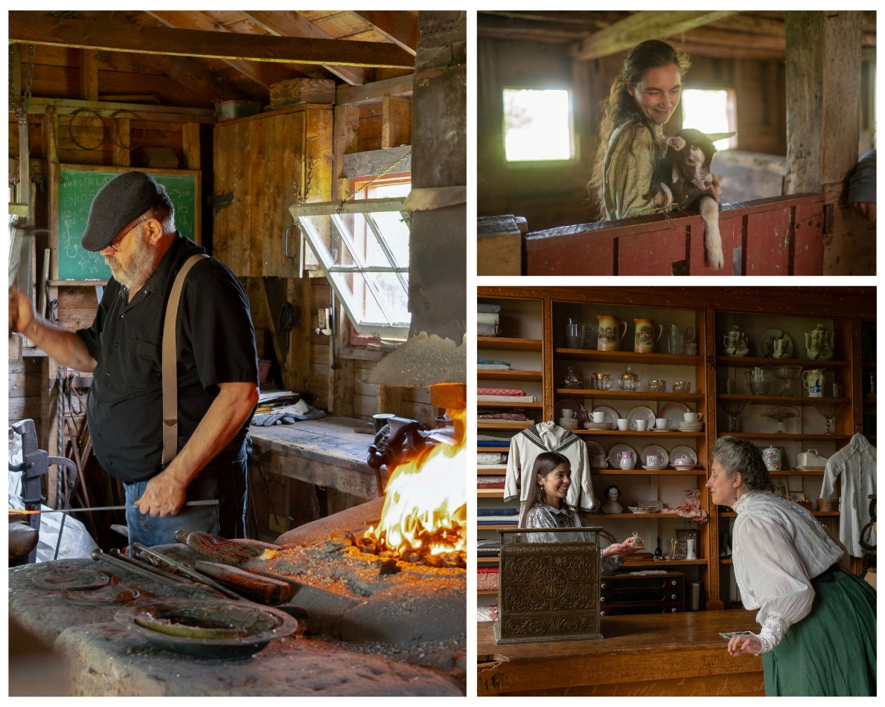
ORWELL CORNER HISTORIC VILLAGE
Kids’ Summer Camps
Forge on the Farm: Blacksmith Experience
Food on the Farm: Bread and Butter
In the Time of Maud
Kids’ Halloween Hauntacular
Notes:
If you have little ones, check out our Kids Summer Camp program, every week in July & August. Through hands-on activities, children will experience life as it was in the 1900s. From churning butter and making ice cream to blacksmithing and caring for farm animals, campers will have an experience like no other. Fun, learning, and a little time travel - all packed into an unforgettable week.
Check out our popular “Food on the Farm: Bread and Butter” program where you’ll make traditional Scottish sourdough bread and the butter to put on it – then go home with your delicious bounty!
If you’re an Anne fan, and who isn’t at least secretly, pre-book the group tour “In the Time of Maud” for an immersive 3-hour experience where our costumed guide leads you through the village, connecting Orwell Corner’s authentic late-Victorian charms to Montgomery’s life and facilitating hands-on historic activities. Visit our adorable farm animals, learn to dance on the village green, enjoy some afternoon tea, and follow in Montgomery’s footsteps by taking a wagon ride along a route she literally travelled in 1910!
And the fun doesn’t end there! Orwell stays open until near the end of October so we can bring you our fan favourite Kids’ Halloween Hauntacular where we decorate the village, dress up our staff in Halloween candy, and welcome treat r’ treaters all across the village, host games and activities, we even have a Witch on call for potion making classes!

Slide 16
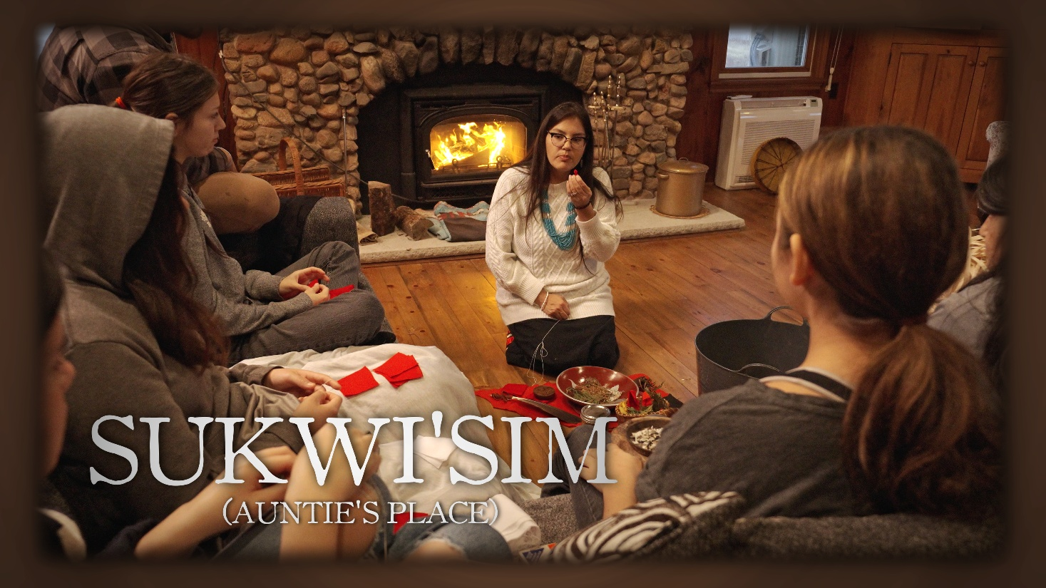


Hidden Island
(formerly Island Digital Voices)
https://www.hiddenisland.ca/
The intent of the project includes two key elements:
  To encourage community members to record and share their oral and written histories
  To provide aspiring storytellers the opportunity to practice their craft in a professional setting
Notes:
The Hidden Island (formerly Island Digital Voices) project was founded in 2021. It is an initiative of the Government of Prince Edward Island, administered by the PEI Museum & Heritage Foundation.
We have four seasons so far and plans to continue so long as funding keeps up.
The stories featured on this website are mostly gathered and created by aspiring storytellers in the province.
If you would like to suggest a story to be featured in future seasons of the Island Digital Voices project, please contact us!

Slide 17

the hidden island podcast
Discover the hidden history of Prince Edward Island - and find out why that history is still relevant today.
5 seasons and counting!
24.2k downloads with listeners all over the globe.
Episode highlights include:
  “If these walls could talk: PEI’s Architectural Marvels with Heather Harris
  Dimetro-Do’s and Dimetro-Don’ts: Prehistoric PEI with Laura MacNeil
  Fiona, climate change, and natural disasters on PEI
  Beach please: the story of PEI Tourism
https://www.peimuseum.ca/thehiddenisland
Notes:
Welcome to the hidden island podcast! We are dedicated to exploring our past in new and unexpected ways.
Listen in on candid conversations with community members about the parts of our heritage that often go unmentioned in history books.

Slide 18
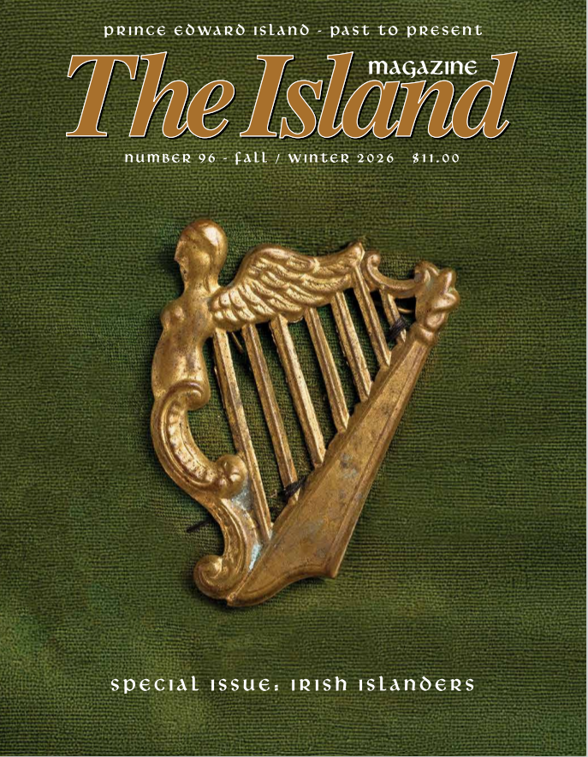
The Island Magazine
Going strong for over 48 years, you'll find more Island history in The Island Magazine than anywhere else!
Each article is lavishly illustrated with photographs, drawings, maps and original artwork.
The emphasis is placed on readability, but style is never put before substance.
Your support is extremely important. We count on subscribers and members to help keep The Island Magazine - and the Island's rich history - alive.
https://peimuseumshop.ca/collections/magazines
Notes:
Inside The Island Magazine, there's something about nearly every aspect of our heritage. You'll find people, communities, enterprise, genealogy, natural history and folklore. The PEI Museum and Heritage Foundation takes great pride in producing the only magazine of its kind created and printed entirely on Prince Edward Island.
Back issues are available online via the Robertson Library’s digitization project. All issues can be borrowed from the public libraries. You can purchase your own copy on our website, or from one of our retail partners: 5th Wave, The Bookmark, Samuel’s Coffee, and more soon!

Slide 19




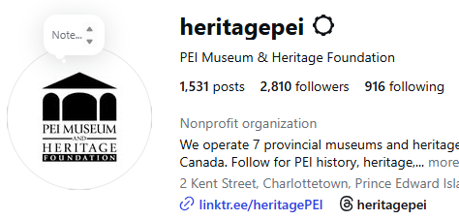

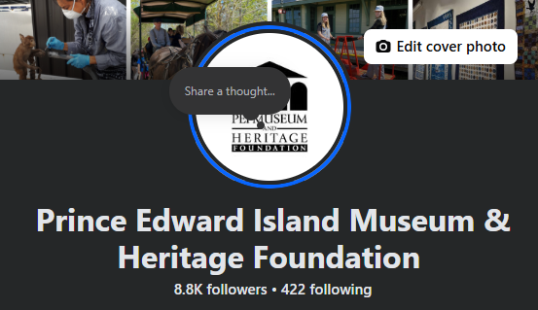
Follow us on social media to be in the know of
the latest events and programs!
/heritagePEI
@heritagePEI
@heritagePEI

Slide 20
Learn more about us!
visit www.peimuseum.ca
call 902-368-6600
email mhpei@gov.pe.ca
Become a member
Enjoy free admissions to all sites, 10% off at gift shops,
and a subscription to The Island Magazine (two new editions annually) starting as low as $60.00 per year.

Slide 21
Questions?
Email: mcrouse@gov.pe.ca
Tel: (902) 368-5537

Slide 22
Thank You!
Email: mcrouse@gov.pe.ca
Tel: (902) 368-5537

