Slide 1
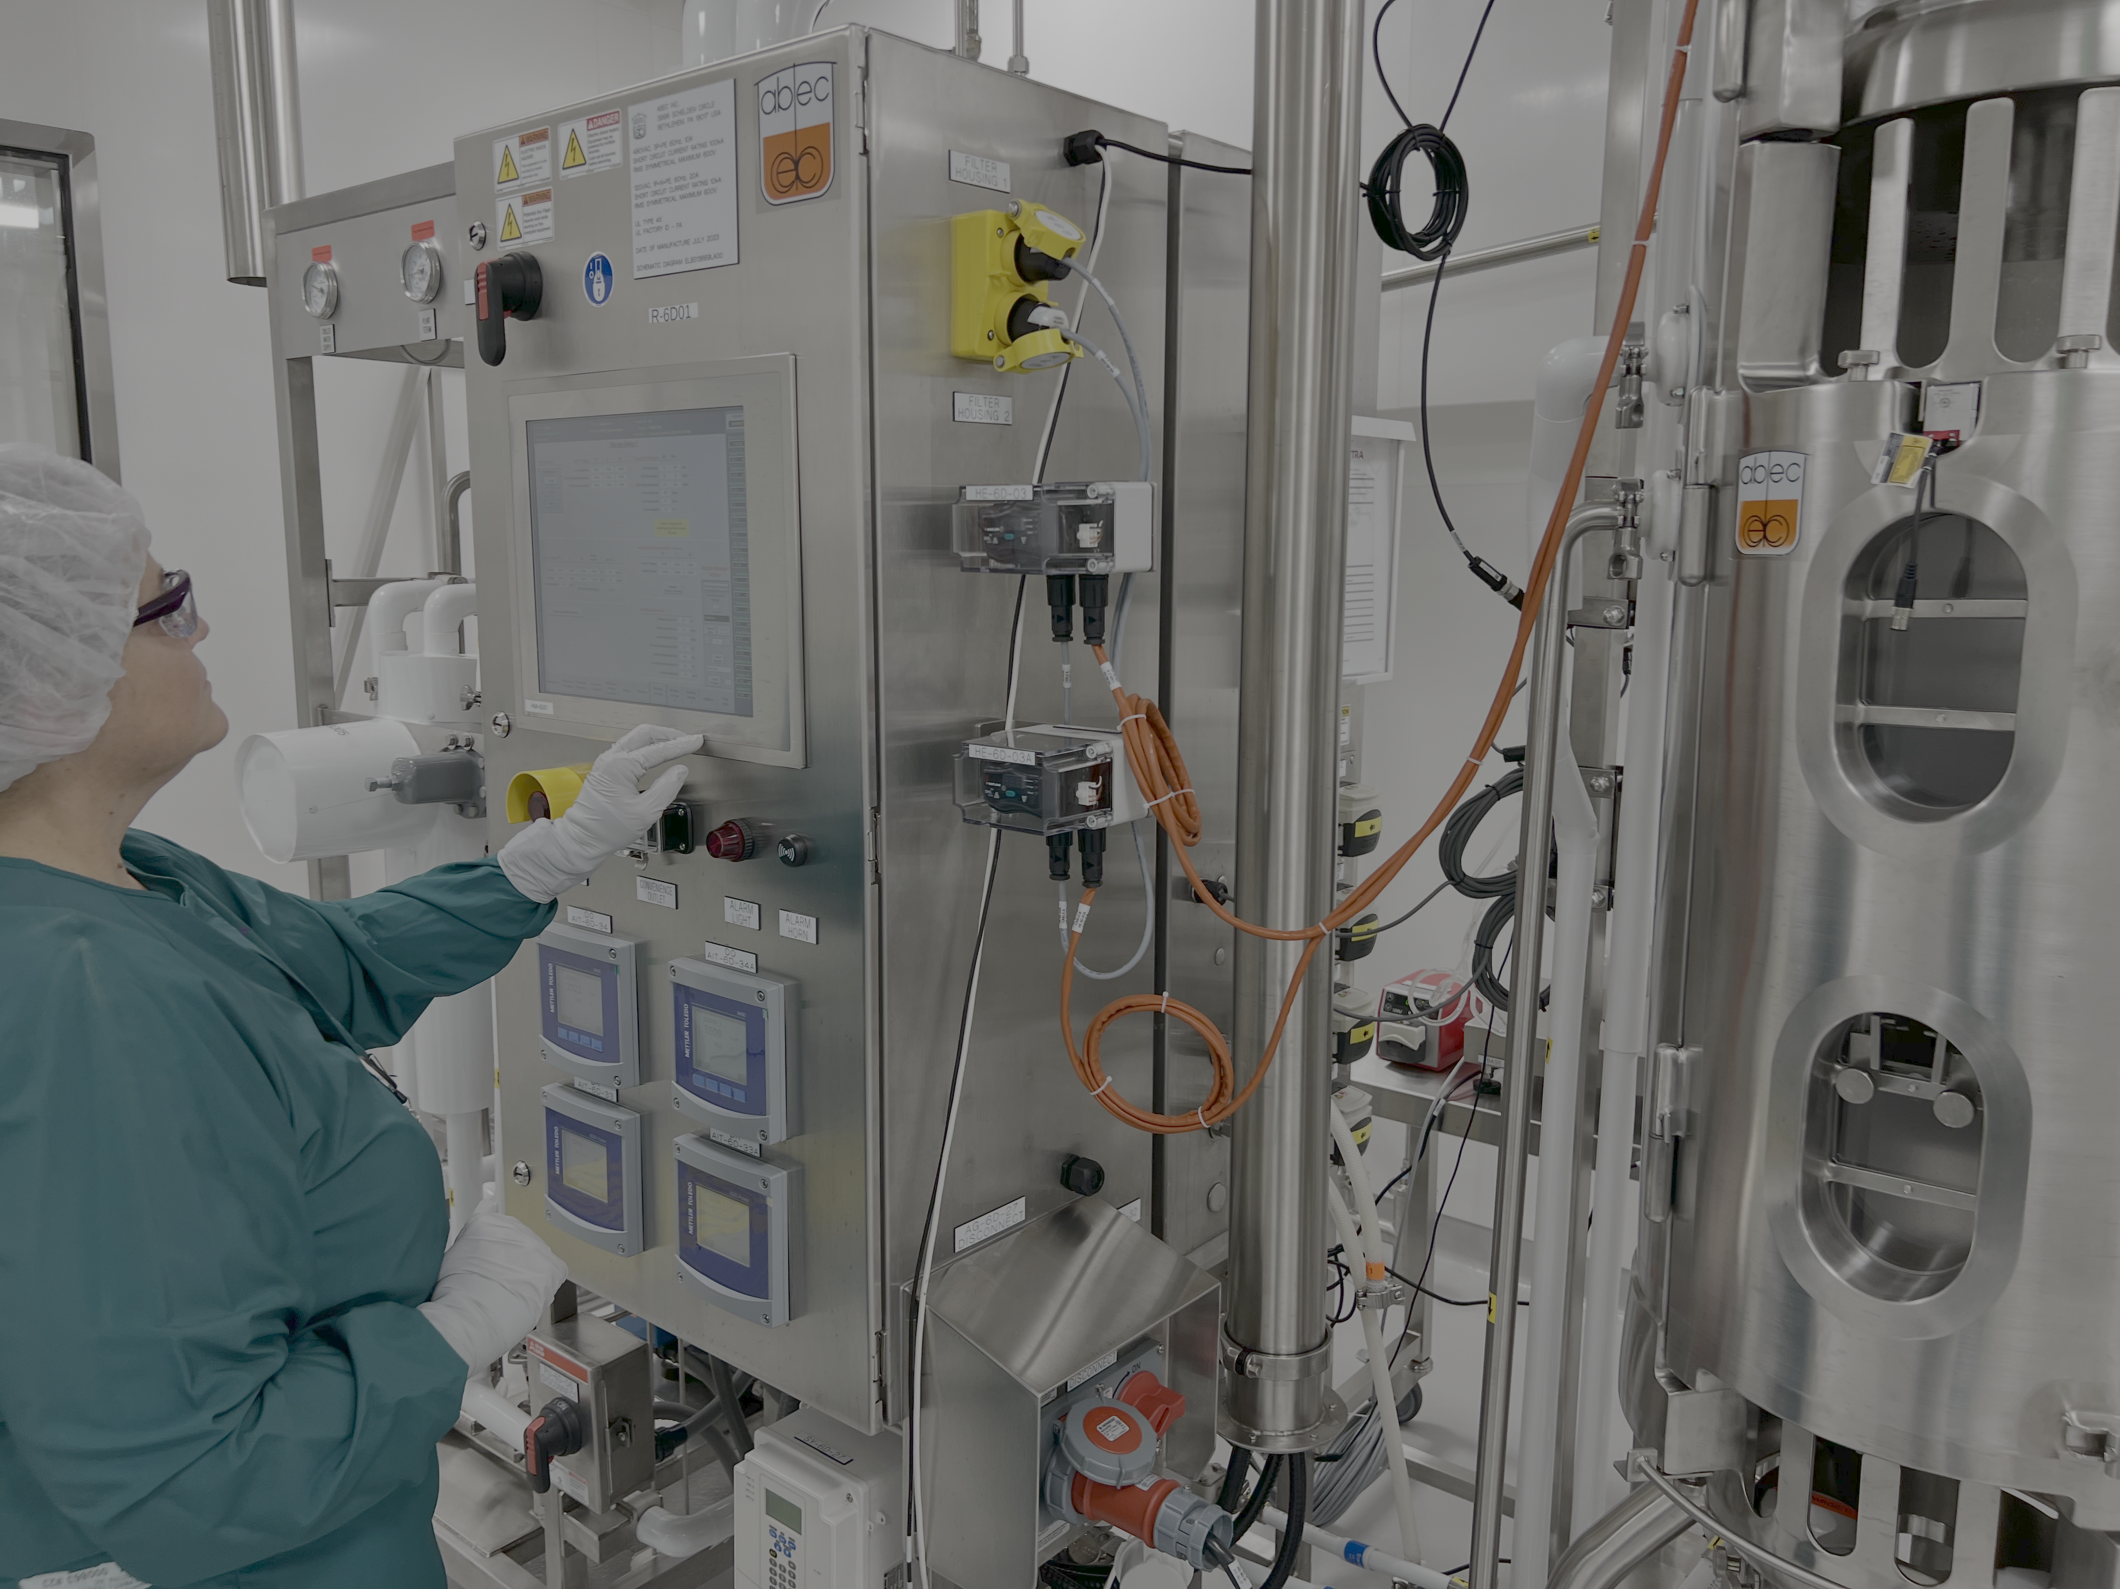

BOUNDLESS POTENTIAL
Presentation to TIAPEI
Bobbi Jo Walker
Director, Communications
Atlantic Economic Panel • February 12, 2026

Slide 2
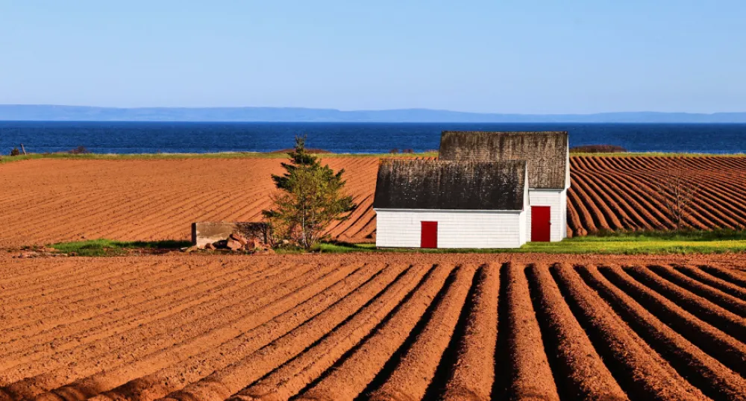
PEI’s POTENTIAL – A CHANGING LANDSCAPE
PEI’s labour force has grown faster than all other provinces over one and five-year timeframes & ranks second over a ten-year period.
Between 2013 and 2023, PEI led the country in the growth of its exports.
Future population growth will rely heavily on a workforce strategy for the Island.
Job vacancy rates remain elevated.
In an increasingly competitive investment environment, PEI must expand export-focused industries to sustain economic growth.
Source: Project Island report by Jupia Consulting for PEI Business Economic Council

Slide 3
THE PEI BIOSCIENCE CLUSTER TODAY
8% of PEI's private sector economy #2 industry in the province, organically grown from the ground up.
$634M
2,100+
$482M
Private Sector Revenue
Direct Employees
Exports
Majority international export
$79K average salary
Global market reach
$99M
$106M
40+
Capital Investment
Tax Revenue
Companies
Continued growth
Provincial + Federal
Integrated cluster
#1
in Canada for pharma R&D spending per capita ($61.61 vs $23.93 in Alberta)
#2
in pharmaceutical manufacturing GDP share among all provinces

Slide 4








































Biocluster Ecosystem

Slide 5
PEI Bio Success Stories
2024 - Five billion-dollar transactions in Canada, 2 from PEI.
40%
$1.25B
$1.75B
BIOVECTRA → Agilent
Elanco Aqua → Merck
of Canada's unicorn deals came from tiny PEI
Global CDMO of biologics, new modalities, APIs, & drug development services
Animal health and aquaculture vaccines innovation
KEY “FIRSTS” FROM PEI
First DNA-based vaccine for animals approved globally
First biomanufacturing fill & finish for mRNA vaccines
First GMO fish approved for enhanced salmon production

Slide 6
PATH TO $2B+ GDP IMPACT – PEI's ROLE
From $634M revenue today to $1B+ by 2030 — here's how we get there in PEI
$1.05B
Target
$980M
$920M
$1000M
$850M
$780M
$700M
$750M
$634M
Current
$500M
$250M
$0M
2024
2025
2026
2027
2028
2029
2030
GROWTH DRIVERS
• Anchor company expansion (BIOVECTRA/Agilent, Sekisui, Merck)
• Scale-up of existing SMEs with better access to capital
• New market entrants attracted by talent pipeline
• Regional coordination unlocking adjacent opportunities

Slide 7
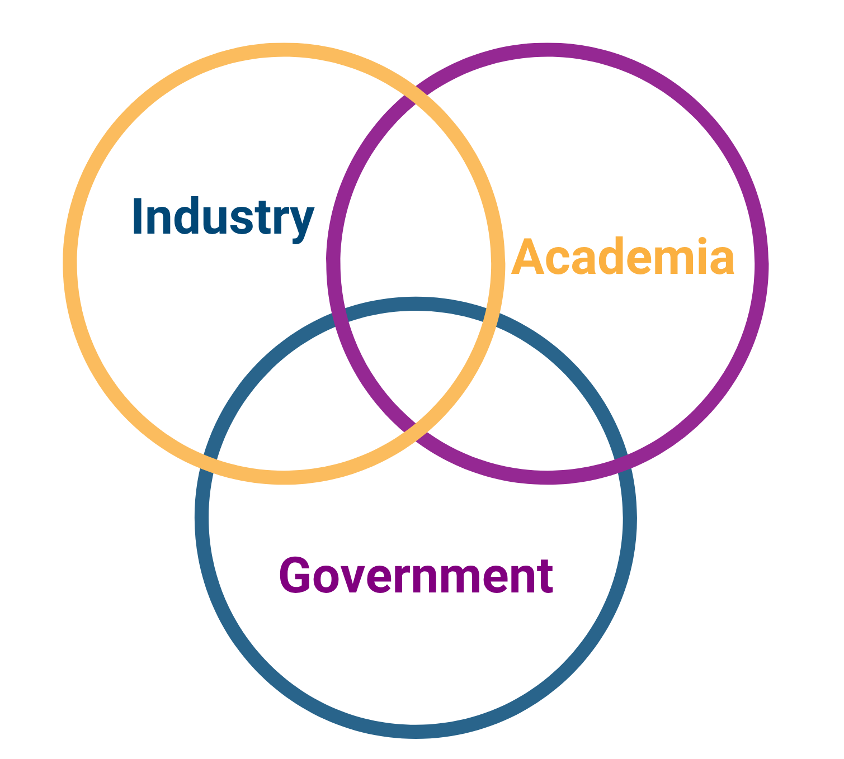
OUR THE CLUSTER MODEL
20+ years of deliberate ecosystem building
Industry-Led Governance
Private sector drives priorities with government as partner
Concentrated Research Assets
NRC, UPEI/AVC, Holland College in close proximity
Shared Infrastructure
Common facilities reduce barriers to entry
Direct Access
Small jurisdiction = direct lines to decision-makers
Culture of Collaboration
Competitors cooperate for collective success
Unique approach to economic development

Slide 8


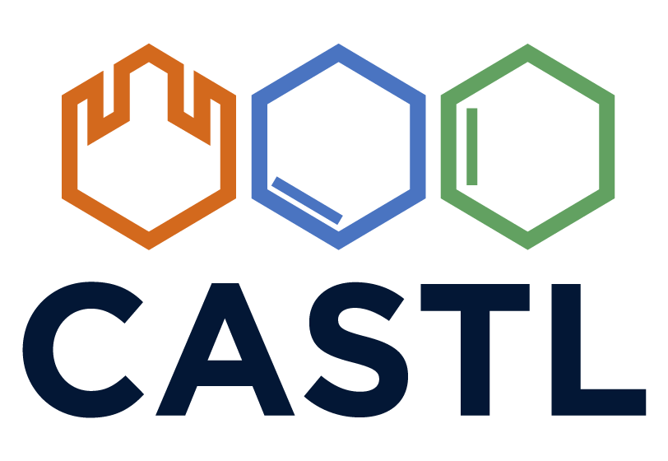


PEI’S NATIONAL SECTOR LEADERSHIP
Atlantic Canada’s bio incubator for bioscience startups and scaling companies supporting 50 companies per year, generating $250M in sales, and $224M of capital investment. Business strategy, mentoring, access to capital, and funding for specialty projects provided.
The Canadian Alliance for Skills and Training in Life Sciences develops skilled talent for the country’s growing life sciences an biomanufacturing sector. Reskilling and upskilling programs in realistic training environments. Only NIBRT curriculum licensee in Canada with locations in Charlottetown, Montreal and Vancouver.
NPC is a not for profit focused on Canadian natural product innovations to replace synthetic products to benefit people, animals and the planet. It provides a one-stop shop for strategic insights, programs and services to anyone looking to participate in Canada’s natural product industry.

Slide 9
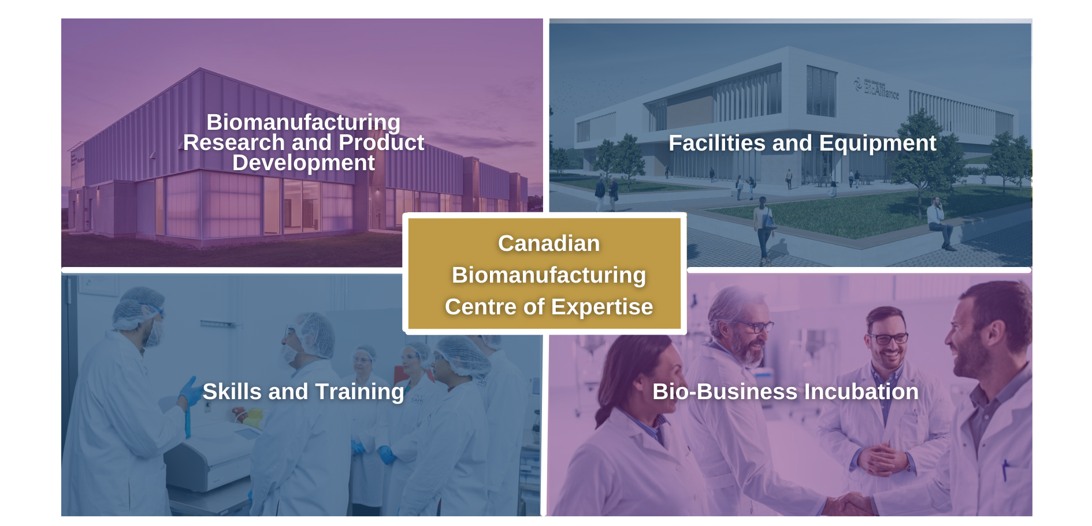


PEI: Canadian BioManufacturing Centre of Expertise
Notes:
Add UPEI/ HC; New pic of BioAccelerator and label. Label BioManufacturing Incubator; Incubation and Acceleration; CASTL people plus logo? Links to each?

Slide 10
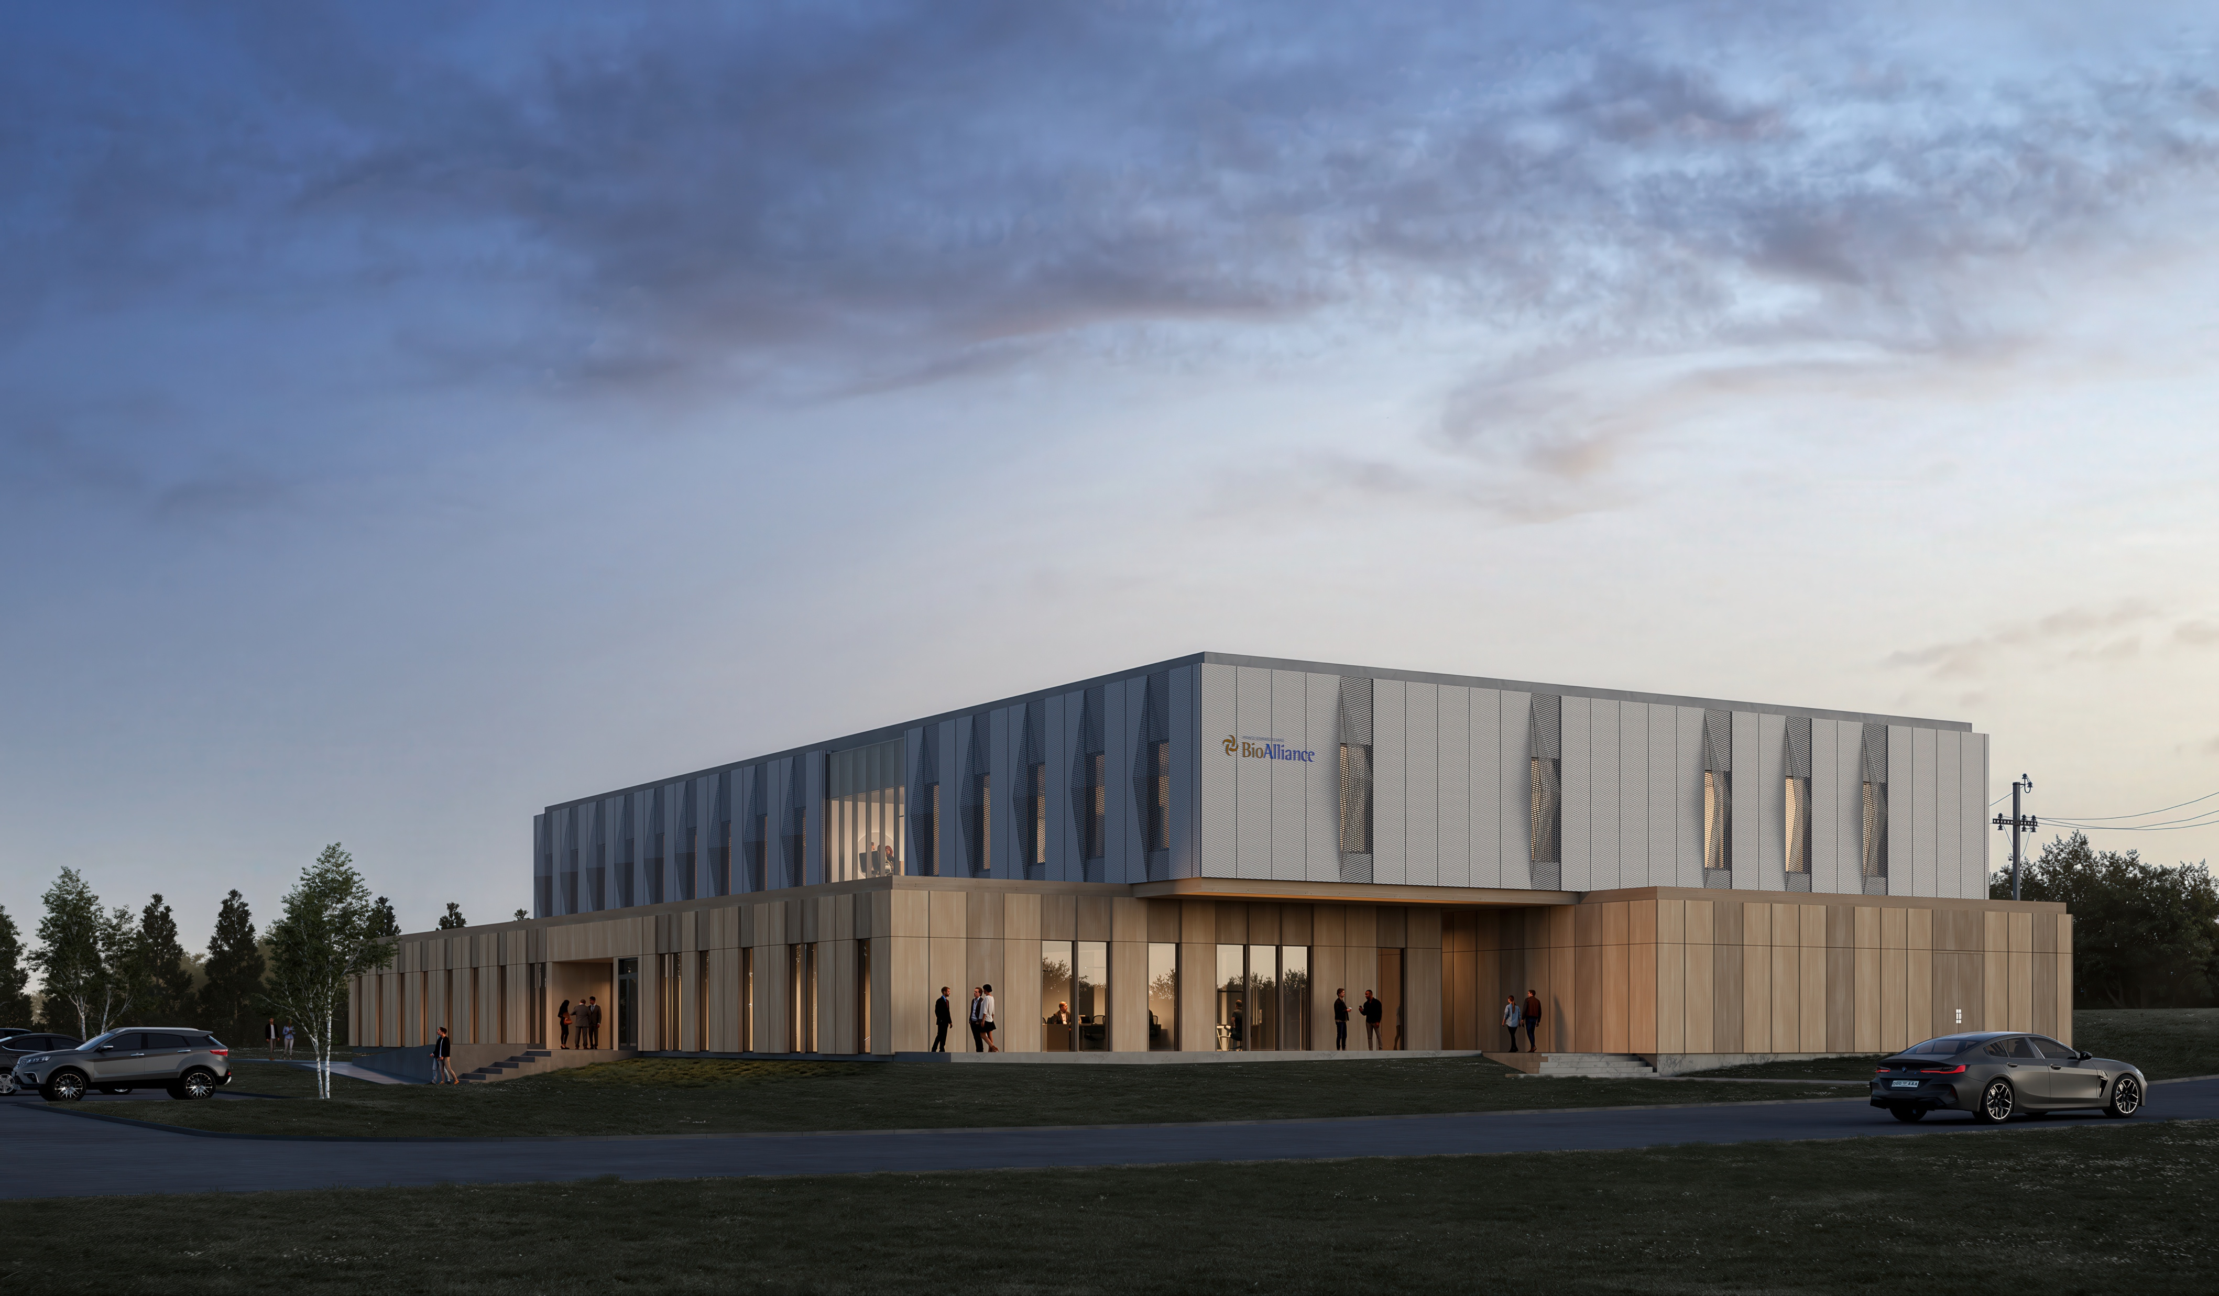
COMING SOON: BIOACCELERATOR
Multifunction Facility​ 38,830 sq ft
National Research Council
CASTL Bioprocess Training Facility
R&D Incubation space
Opening 2027

Slide 11
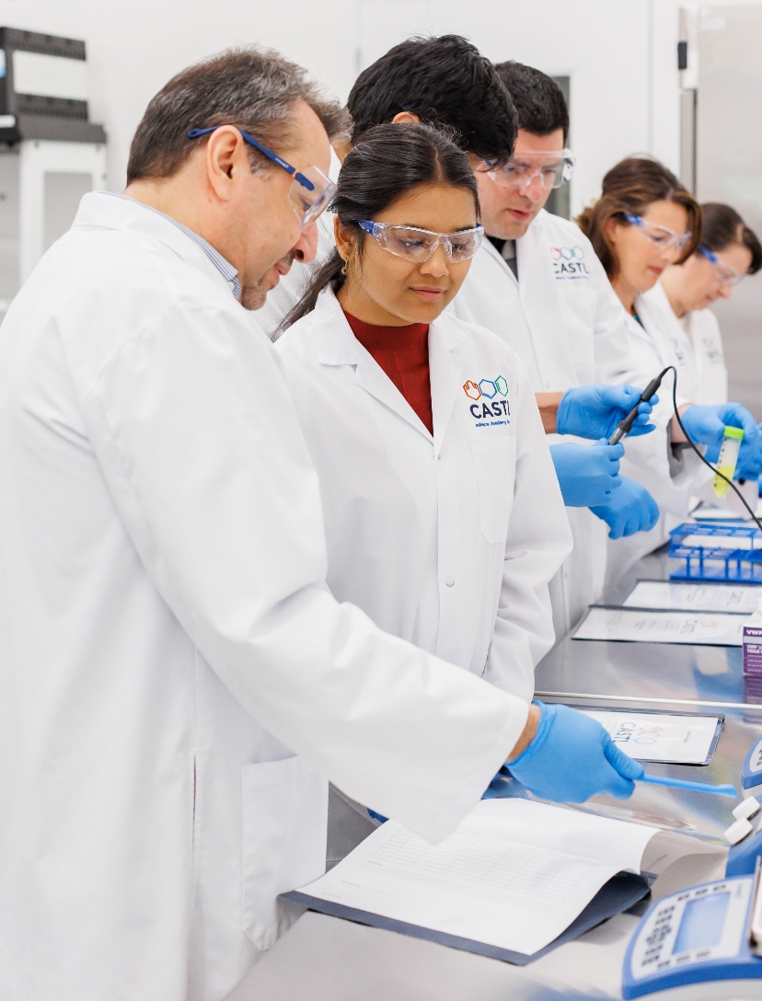
BUILD IN
BIOSCIENCE
"
Innovate or die; the alternative is not that appealing
- Dr. Regis Duffy
from The Chemistry of Innovation: Regis Duffy and the Story of DCL
The PEI bioscience cluster is proof that Atlantic Canada can compete globally & lead nationally.
Future Prosperity

