Slide 1

Industry Partner Day
March 26, 2026

Slide 2
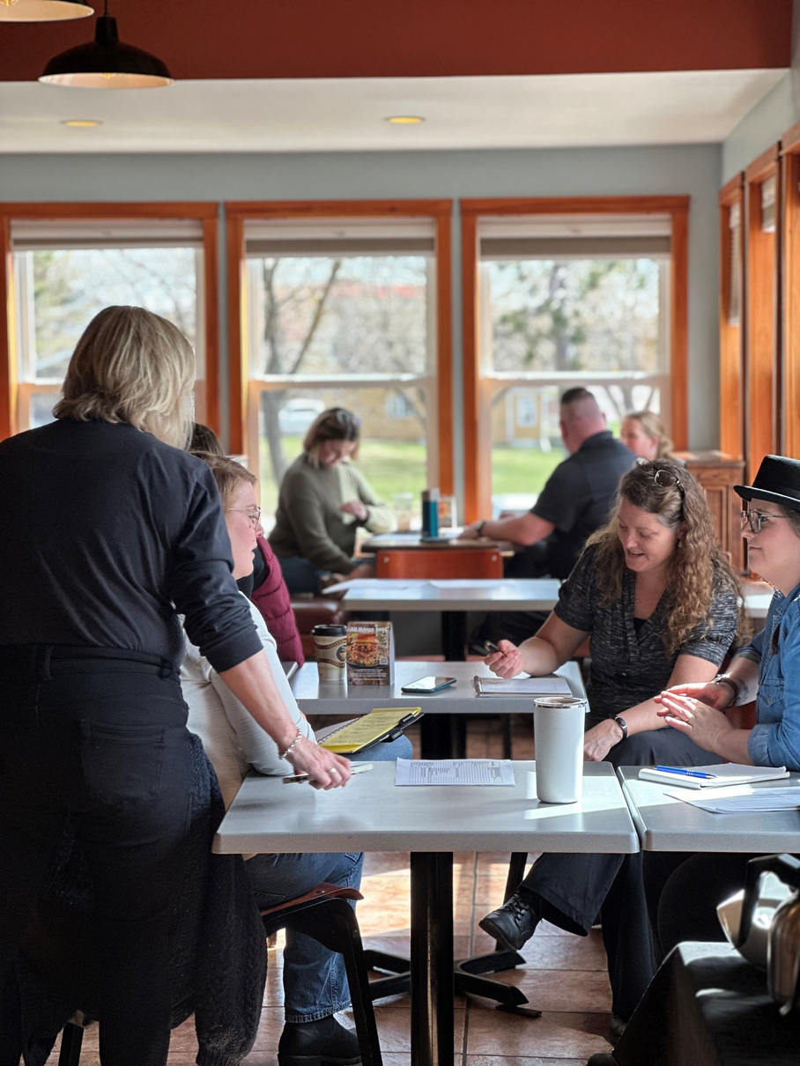



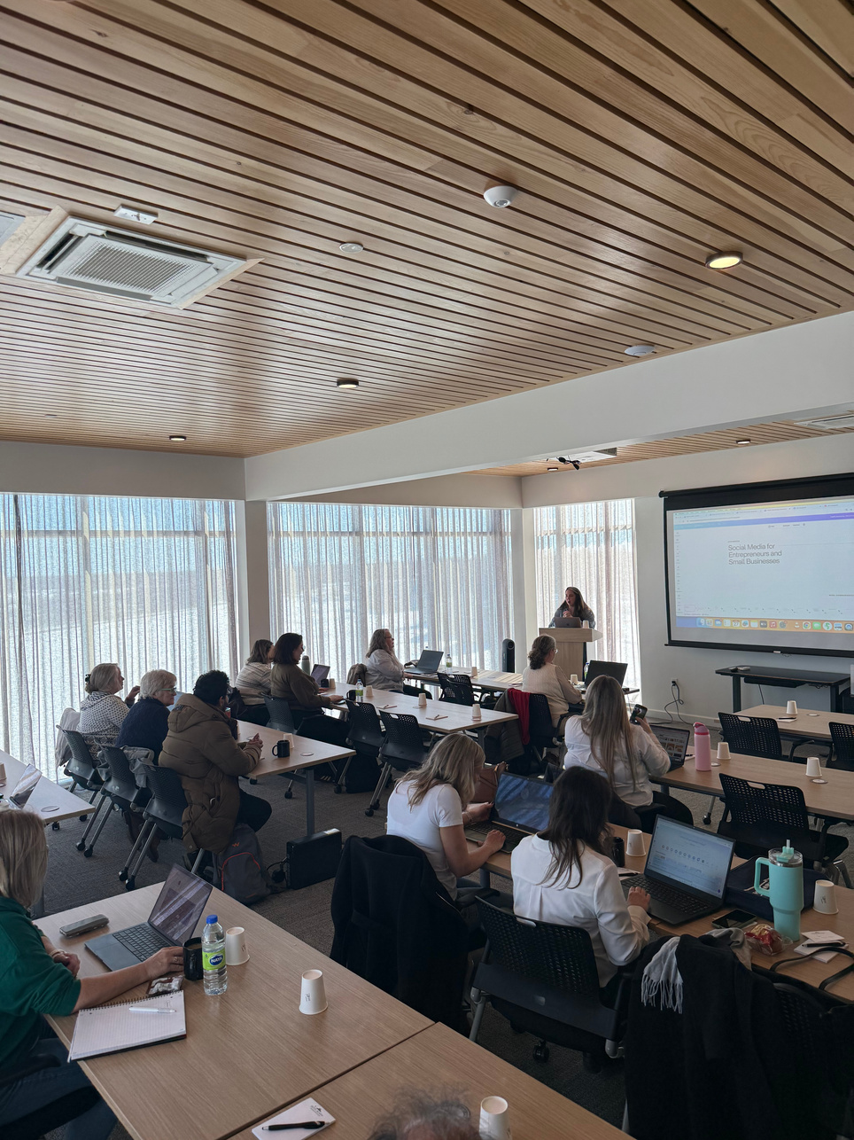





Membership Benefits
GROUP BENEFITS COVERAGE
NETWORKING OPPORTUNITIES
PROFESSIONAL DEVELOPMENT PROGRAMS
FREE & CONFIDENTIAL HR SERVICES
TRAINING PROGRAMS
TOURISM WELLNESS PROGRAM

Slide 3

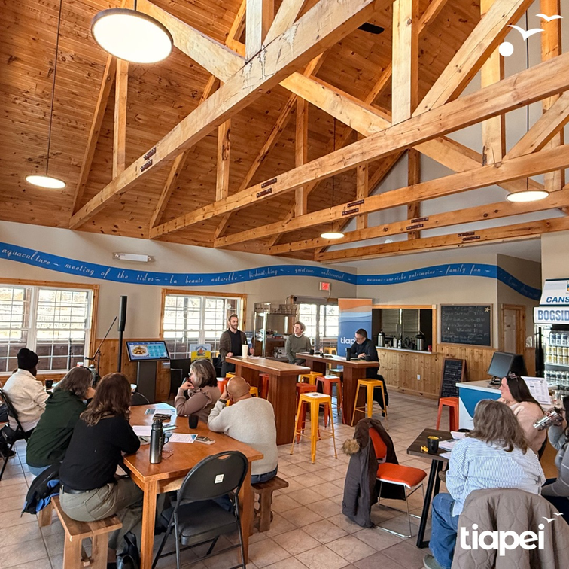
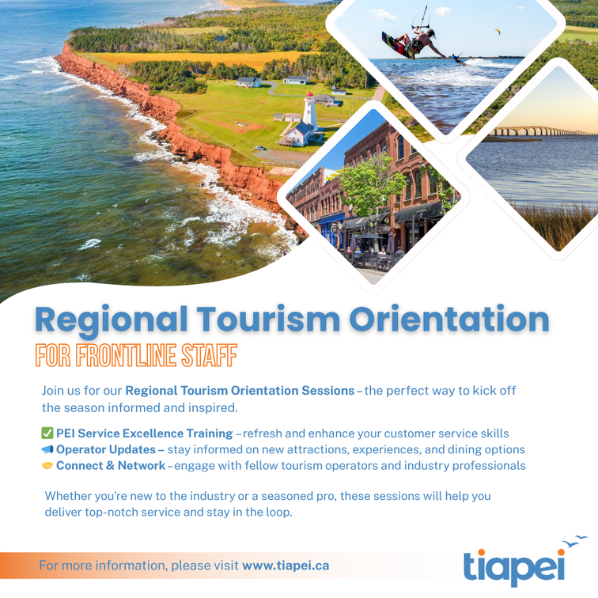


Slide 4


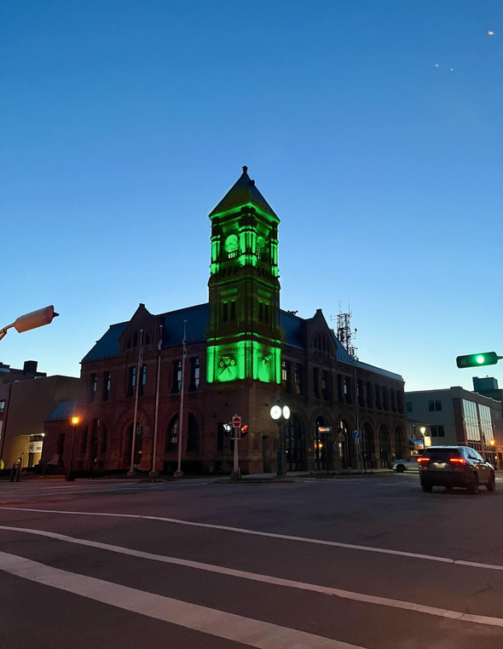


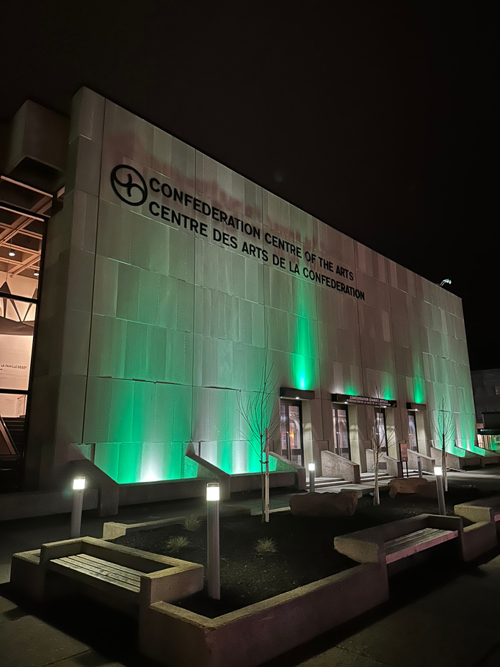

Annual Tourism Conference & AGM
National Tourism Week
Raising the Bar: 2026 Tourism Season Launch
How to Take Part:
  Light up green in support of tourism week
  Post at least once during the week
  Use the hashtags #PoweredByTourism and #NationalTourismWeek
  Tag TIAC and TIAPEI
  Register for Raising the Bar: 2026 Tourism Season Launch (April 20)

Slide 5

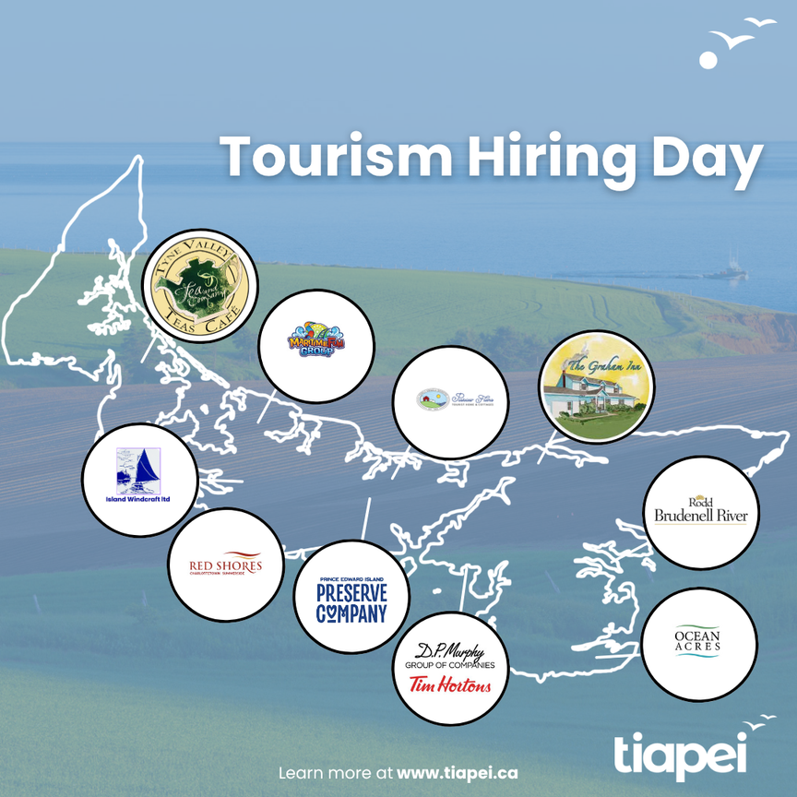
Pathways to Employment

Slide 6


Slide 7

Background
  TIAPEI patnered with James Cronk in late 2024.
  Course is an adaptation and extension of “PEI Best Service Excellence”.
  New content generated in consultation with industry.

Slide 8
The Challenge
  Employee training for seasonal businesses.
  Young staff taking on their first customer facing role.
  Finding the time to curate an exceptional visitor experience.

Slide 9
The Opportunity
  To build a PEI tourism workforce that has the tools to drive repeat business.
  Turning small interactions into meaningful guest moments.
  Accessable training that can be completed outside of peak-season.

Slide 10
Let’s try it!

Slide 11
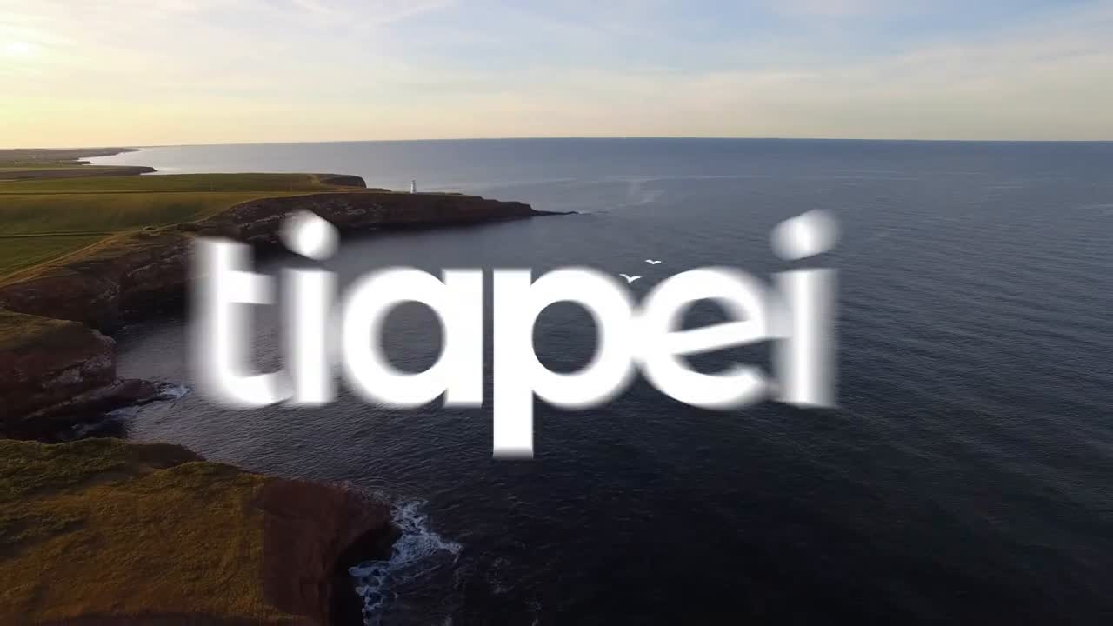

Slide 12
The ‘Test’
  What do powerful “above and beyond” moments usually cost?
  Which is an example of going above and beyond?
  What’s the key to spotting opportunities?

Slide 13
In the Works
  Group administrator pages for our Learning Management System.
  “PEI Best Business” Certification program and directory.
  Virtual training that is accessable and cost-effective.

Slide 14
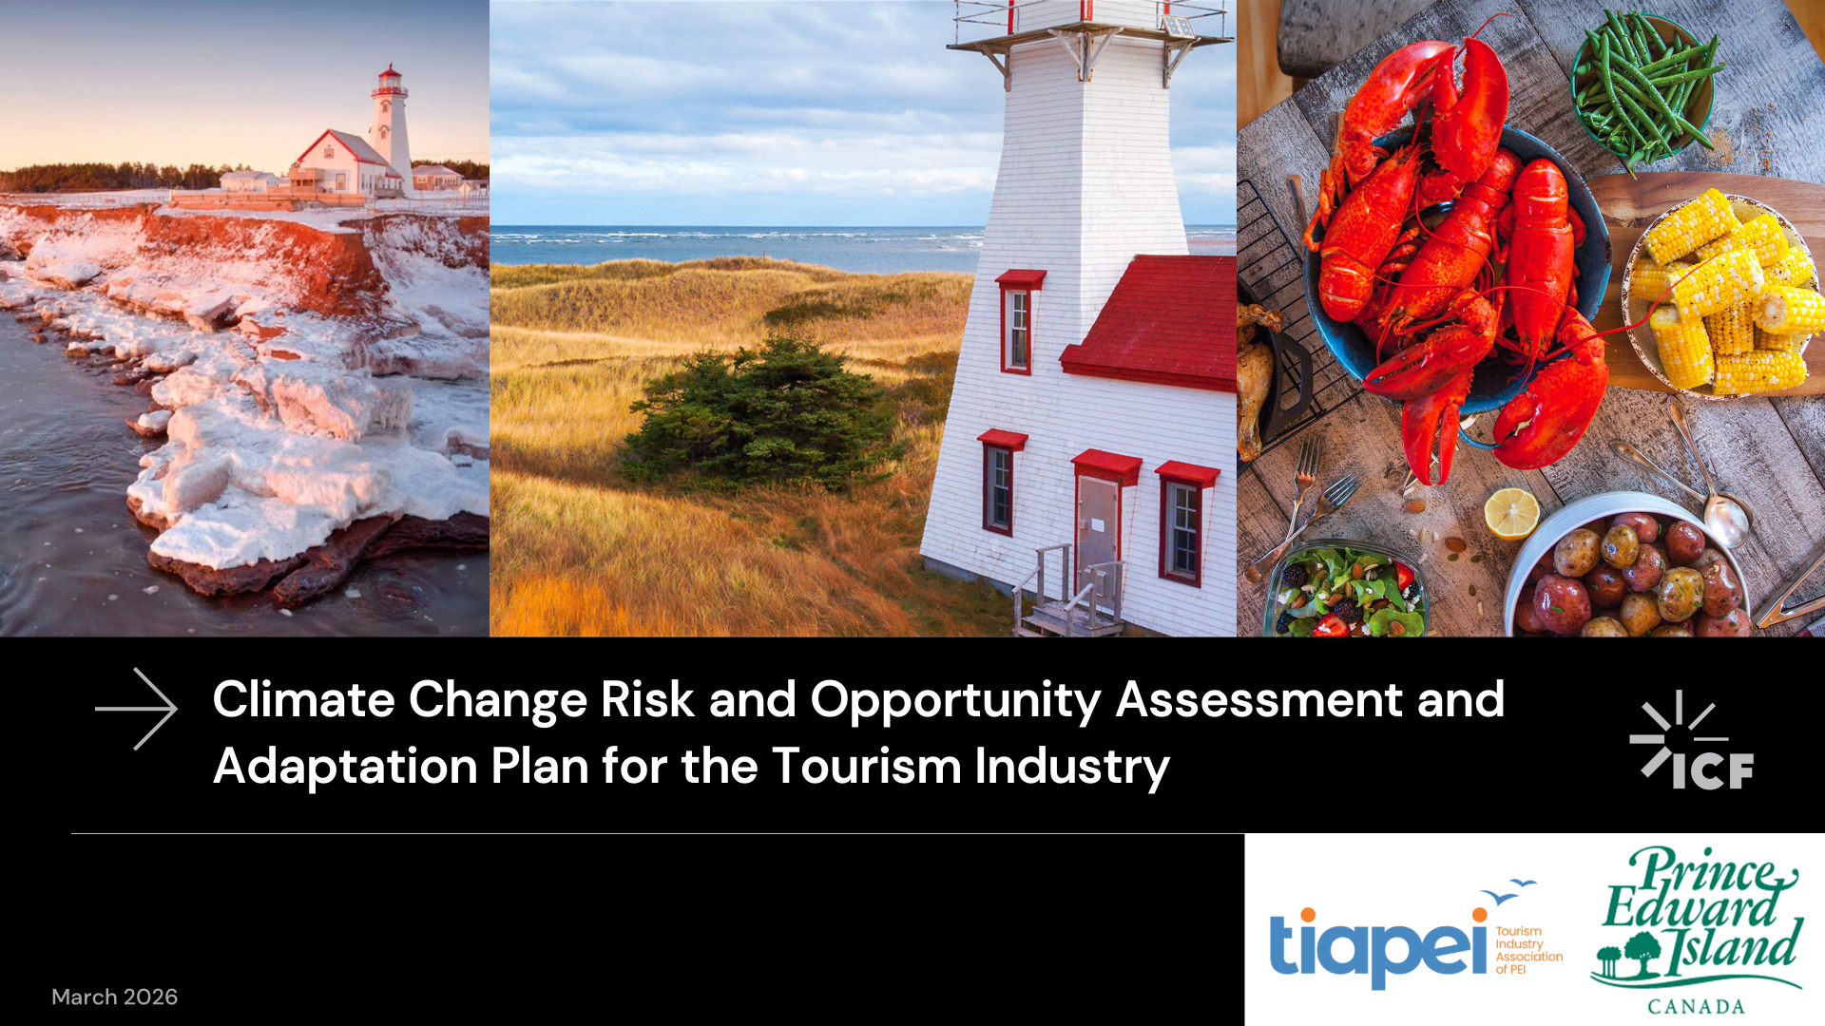

Slide 15
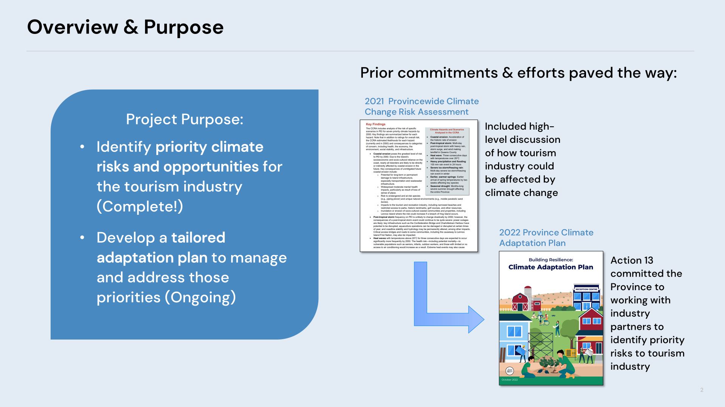

Slide 16
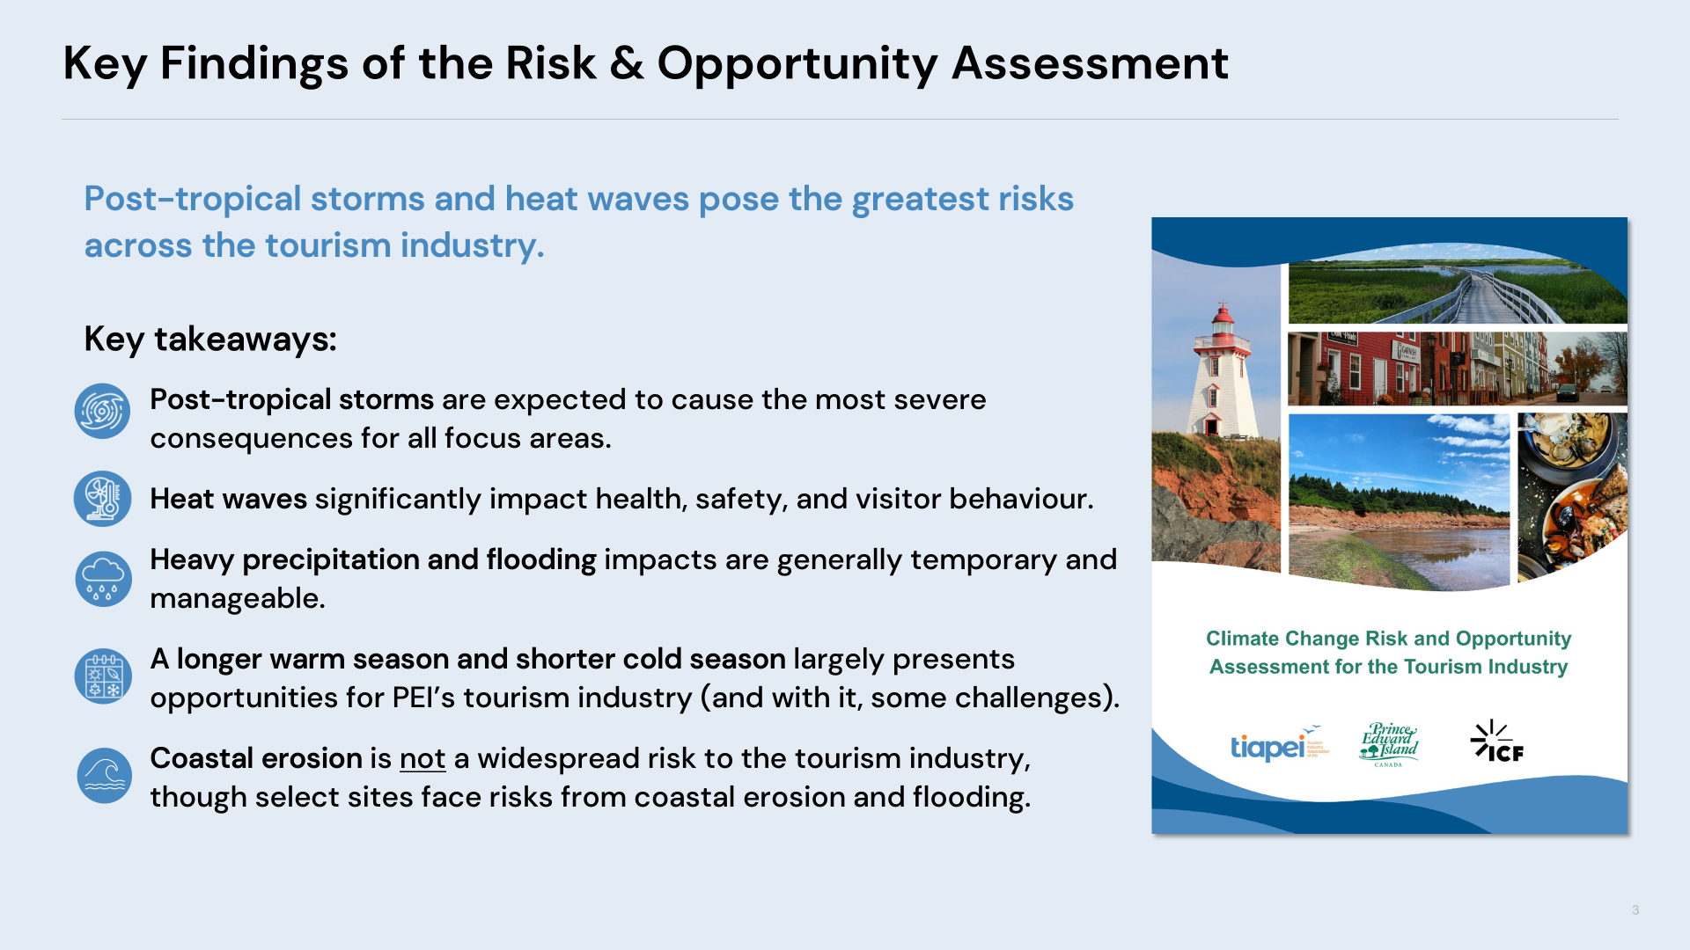

Slide 17
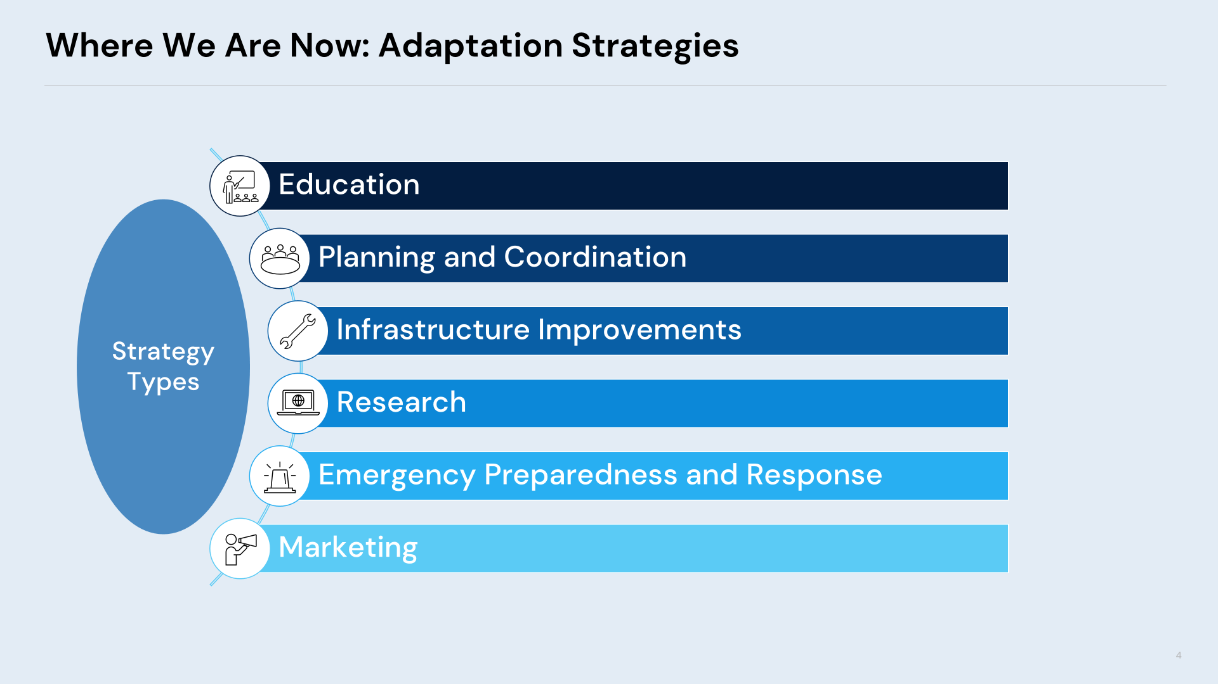

Slide 18
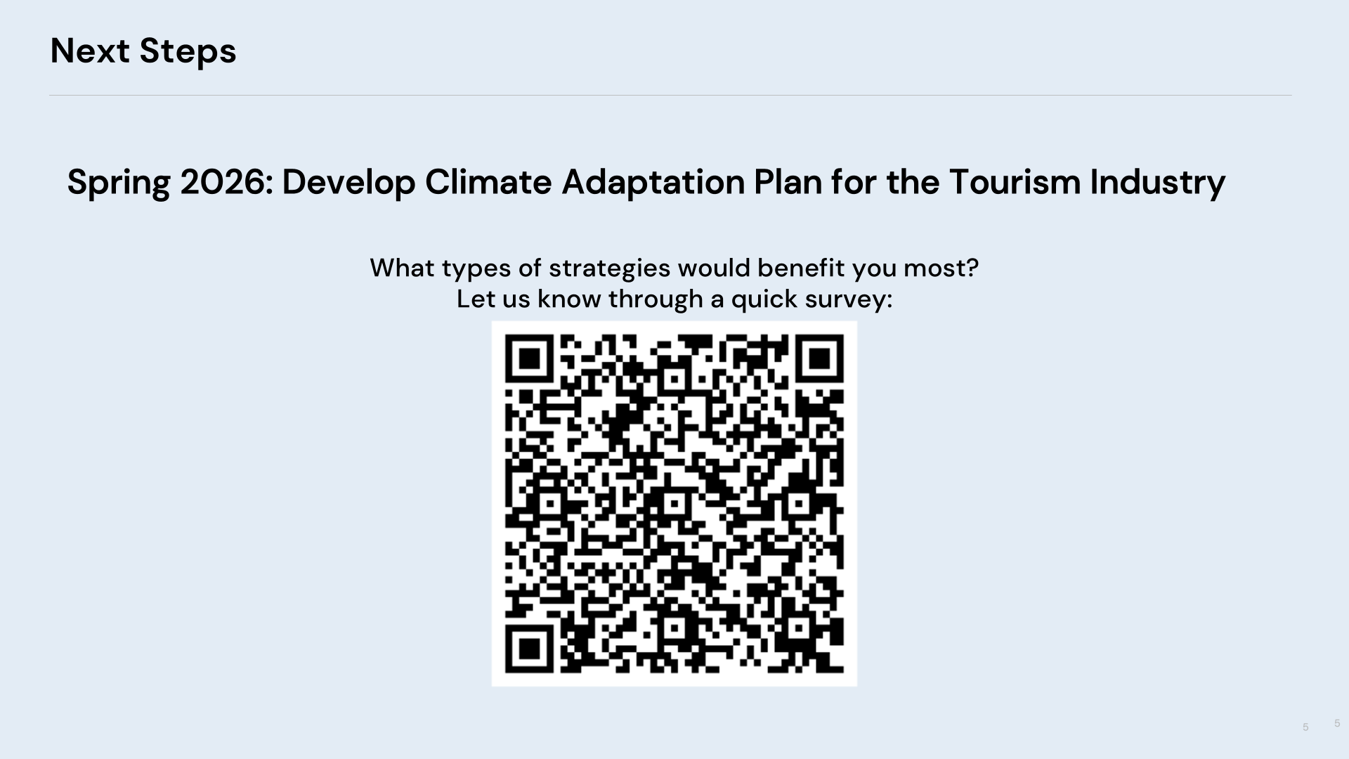

Slide 19


Slide 20





Stay connected!

