Slide 1
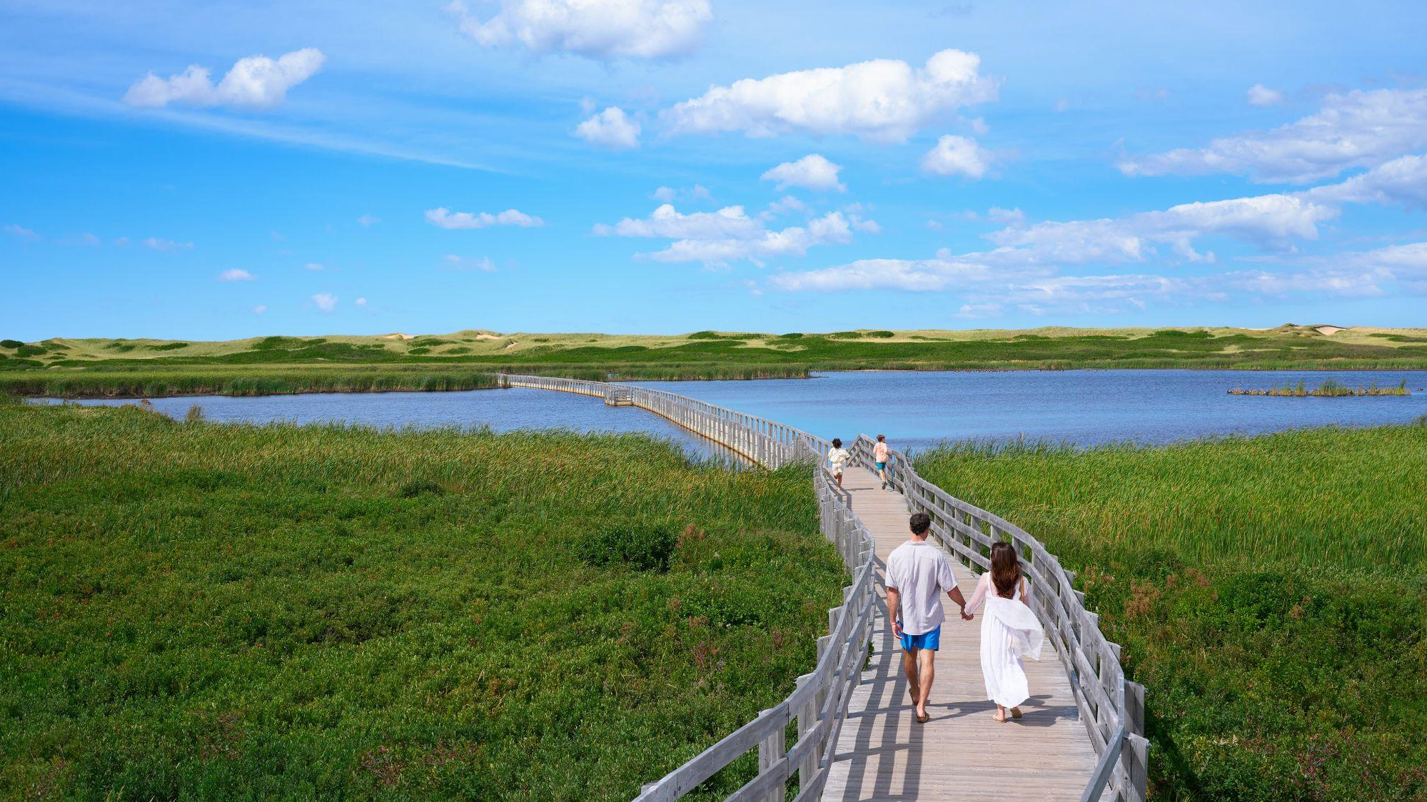

Industry Partner Day
2026

Slide 2
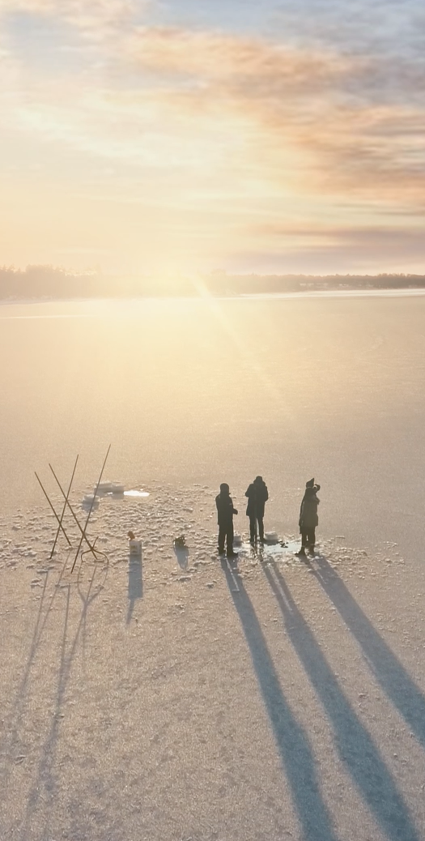
Winter Campaign Highlights
Objectives
Reframe perception of PEI beyond summer.
Generate bookings of winter vacation.
Markets:
New Brunswick
Nova Scotia
Prince Edward Island
Ottawa
Timing: December 2025 – March 2026

Slide 3
Winter Campaign Early Results
Metric | Performance Change | What it Indicates
Website Engagement | +10% YoY | Improved user interaction and content relevance.
Campaign Impressions | +48% YoY | Significant growth in reach and visibility.
CPM | -41% | Greater media efficiency and lower cost per impression.
Clicks to Winter Packages | +118% YoY | Strong audience interest and effective seasonal messaging.

Slide 4


Slide 5
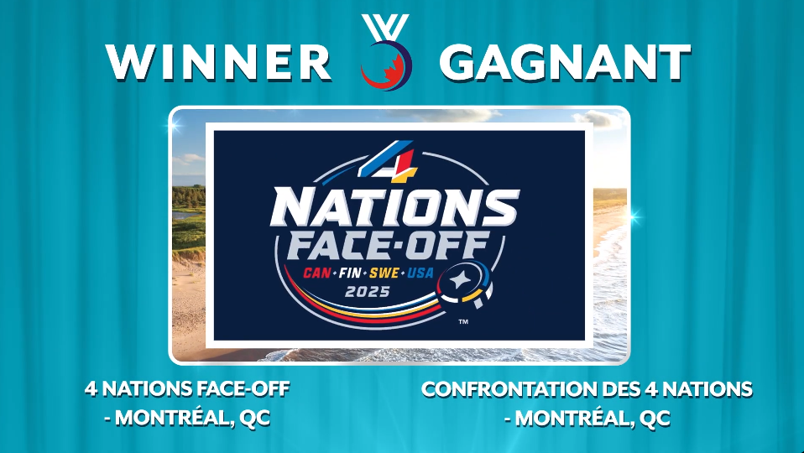
4 Nations Face Off

Slide 6

4 Nations Face Off

Slide 7
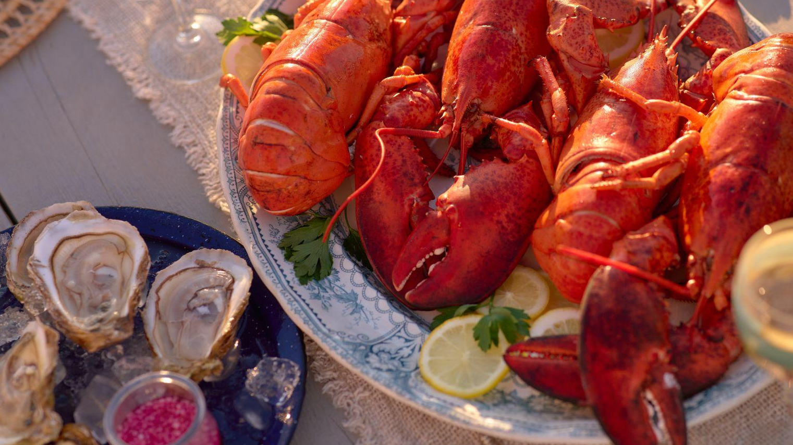
Paid Media Strategy
2026

Slide 8
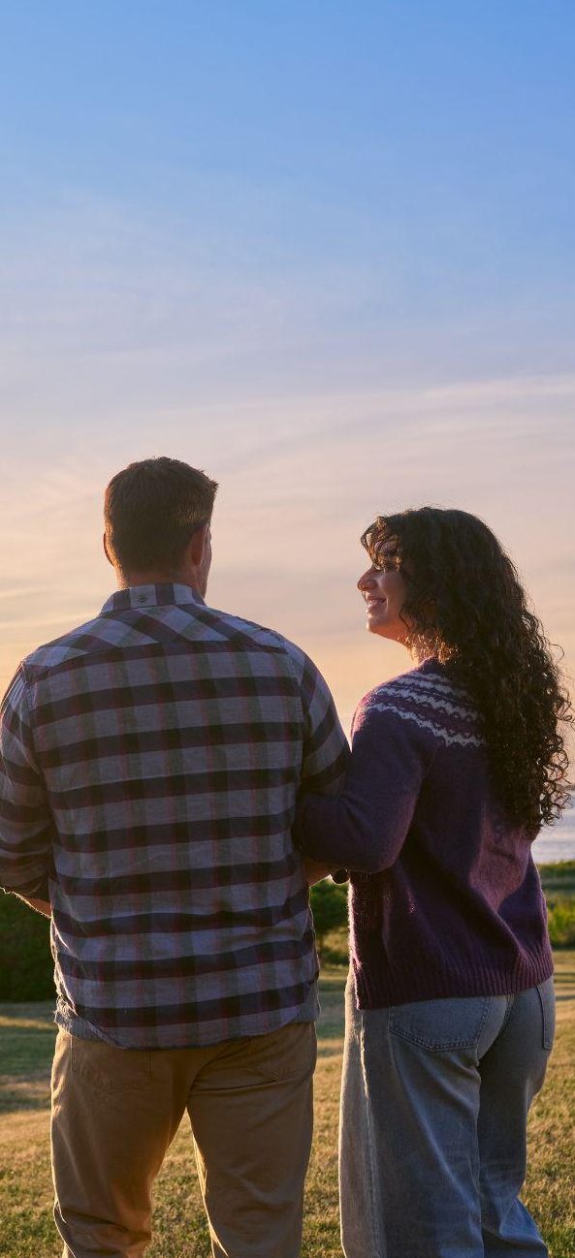
Campaign Parameters
Business Objectives
Drive growth in visitation, overnight stays, and visitor spending, with a sharpened focus on attracting high-yield travelers, while maintaining momentum with established core audiences.
Marketing Objective
Increase awareness, website engagement, and website actions:
Continue to drive awareness amongst valuable audiences over volume.
Capture engaged audiences to drive consideration to visit PEI.
NHL partnership to remain a priority with paid campaign support.
Target Markets
Ontario
Québec
Maritimes – New Brunswick & Nova Scotia
Alberta – Calgary & Edmonton

Slide 9
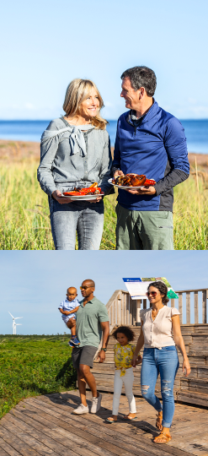
Target Audience
Primary Audiences
The Purposeful Planners (+25)
Suburban and urban adults and families.
Elite Explorers
Upscale Families
Independent Indulgents
Ontario | Québec | Alberta | Nova Scotia | New Brunswick
The Nature Escapists (35-69)
Amis Francophones with a strong connection to nature.
Québec | New Brunswick
Notes:
Atlantic Canada Agreement on Tourism

Slide 10

Target Audience
Secondary Audiences
The Easy Escapers (35-69)
Maritime visitors with flexibility to be more spontaneous.
Atlantic Connections (singles/couples)
Short-Haul Sightseers (middle-aged & older families)
Nova Scotia | New Brunswick

Slide 11

Travel Forecast
Domestic Travel Continues to Rise
74% of Canadians plan to stay in the country for their summer travel plans.
Continue to build the Island’s presence across the entire travel planning journey.
Timing Matters
Media will deliver tailored creative across priority markets to reach the right audiences with the right message, at the right time.
Drive Relevance
PEI’s offering aligns perfectly with Canadian travellers’ interests.
Preference to be outside in non-urban destinations.
Shifting from one-size fits all tours to bespoke journeys.
80% prefer food and drink from the farmers, chefs, wineries and breweries of the destination.

Slide 12
Strategic Approach to Media
Awareness
Goal: Reach & Familiarity
How: Build salience through powerful brand-level creative.
Consideration
Goal: Get people to the website to start planning
How: Showcase brand pillars and what makes us unique, enticing users to plan their visit.
Action
Goal: Encourage our target to take action.
How: Retarget people who have shown intent and push them towards specific conversion actions.

Slide 13



Omni-Channel Video Approach
Leverage high-reach, credible video tactics like Linear Television.
Capture the swell of viewership during Winter Olympics & drive engagement through TV integrations.
Continue to focus on seasonal live sports, which deliver a large highly engaged audience.
Extend our presence across both Connected TV & OLV.
Linear TV
Streaming TV
Digital Video

Slide 14
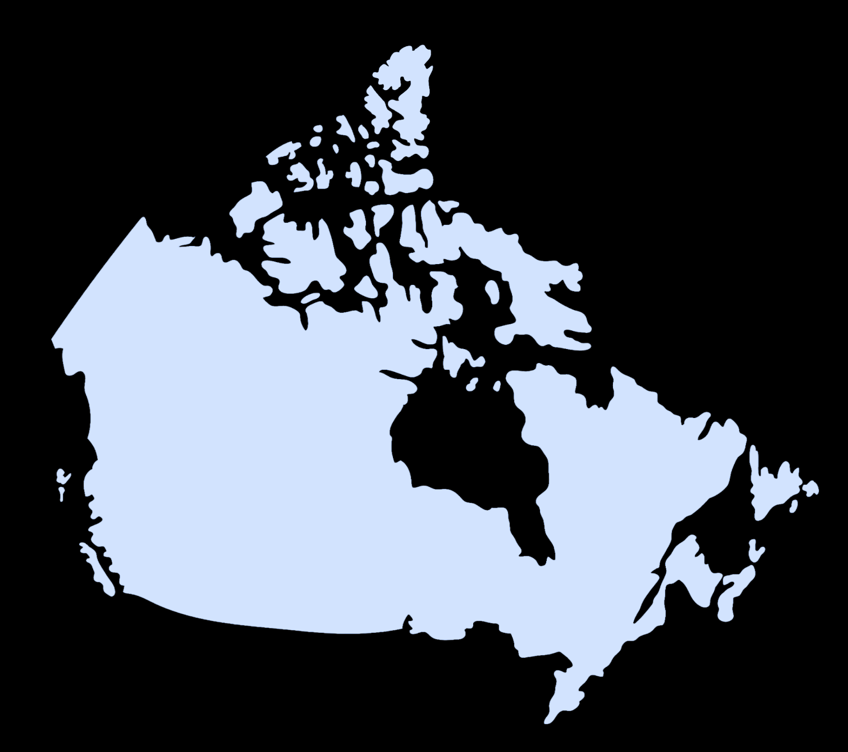

Out-of-Home
Strategy
1. Dominant presence in key markets with unique large-scale placements.
Ontario
Union Station Skywalk domination
UP Express Entrance
Three-panel streetcar
Large-Scale mural in Distillery District
Ottawa Airport landmark wall
Québec
Montréal Airport baggage claim digital signs
Bike rack digital signage
Québec City ferry terminal
Alberta
Calgary Plus 15 Pathway digital signage
Edmonton ICE district digital signage
2. Digital billboards to cost-efficiently extend reach and frequency.
Across all key markets
Ontario | Québec | Alberta | Nova Scotia | New Brunswick

Slide 15
Digital
Highly targeted to high-yield audiences in focused geographical regions.
Awareness
Goal: Reach & familiarity
Connected TV | OLV | Premium Sports | Influencers | Spotify
Consideration
Goal: Get people to the website to start planning
Social Media | Programmatic Display | French First Custom Digital
Action
Goal: Encourage our target to take action.
Meta | Search Engine Marketing | Rich-Media

Slide 16

Leverage the NHL Partnership
Leverage the trusted brand of the NHL to drive recognition & consideration of PEI.
Hockey TV
HNIC regular season
NHL Stanley Cup Playoffs
Digital
theScore digital & video
Sportsnet + live game ads
Prime Monday hockey
PWHL Tuesday hockey
TSN CTV – NHL free agency
Netflix
Golf TV
Masters Tournament
PGA
The Open
US Open
Canadian Open
OOH
Up Express Domination

Slide 17
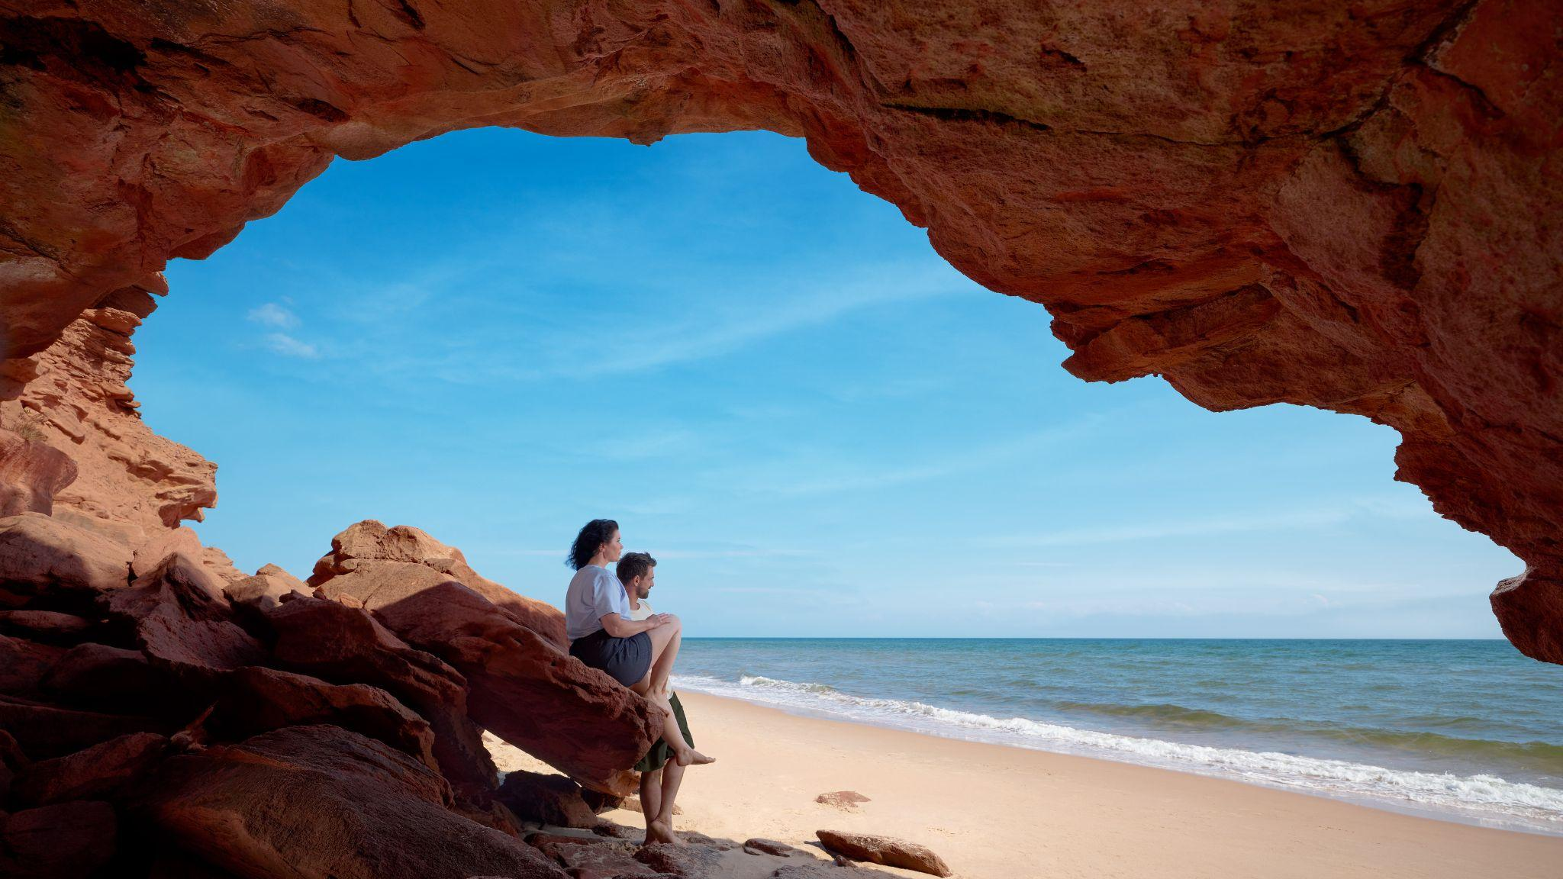
2026 Campaign

Slide 18


Slide 19
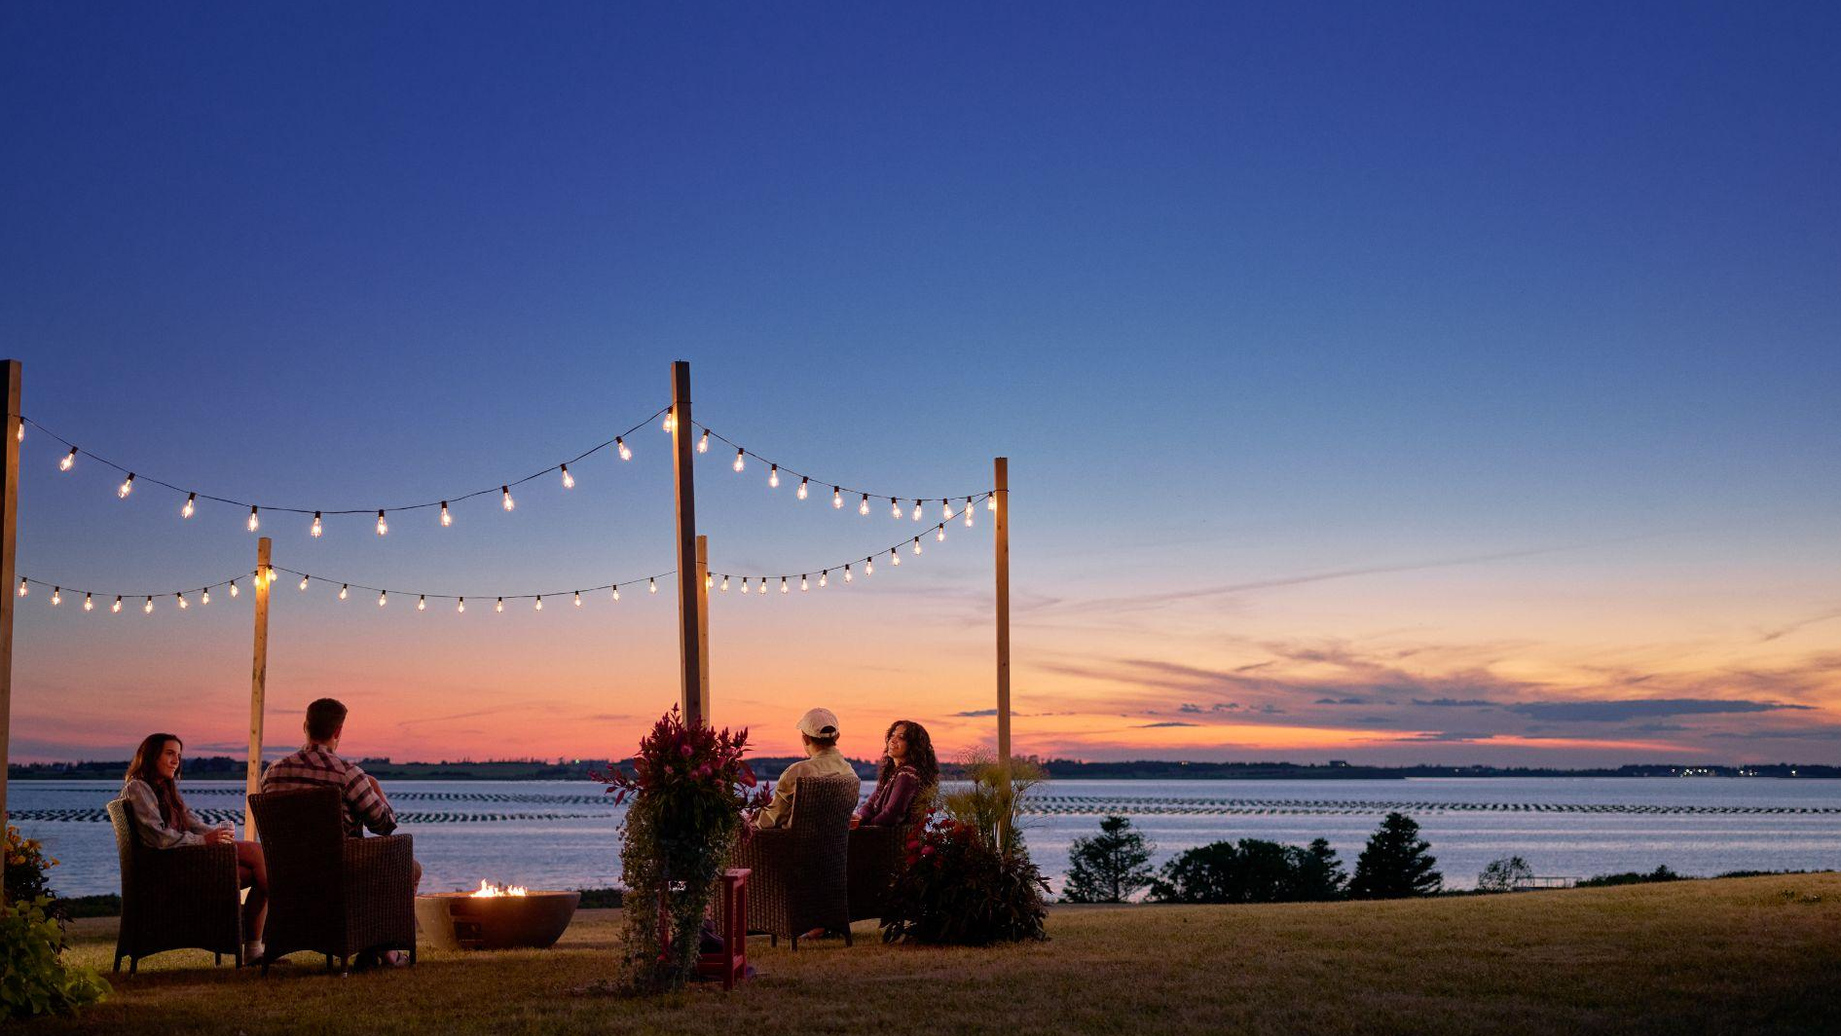
Campaign Videos

Slide 20
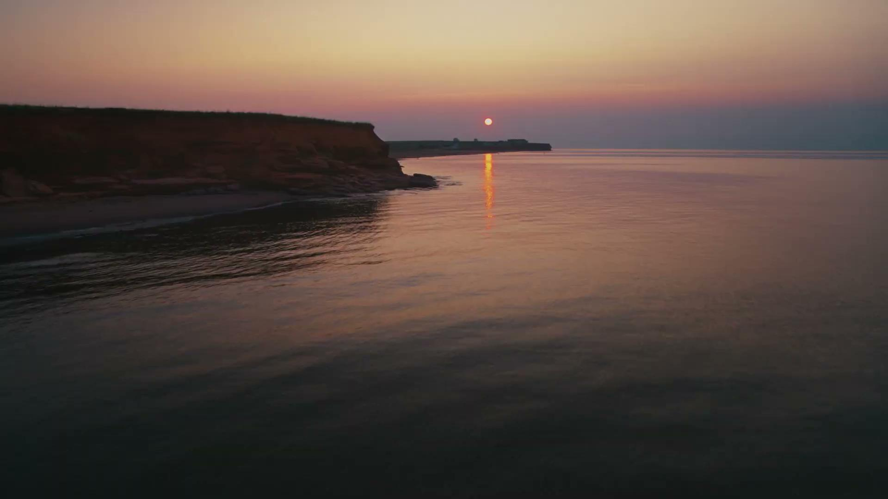

Slide 21
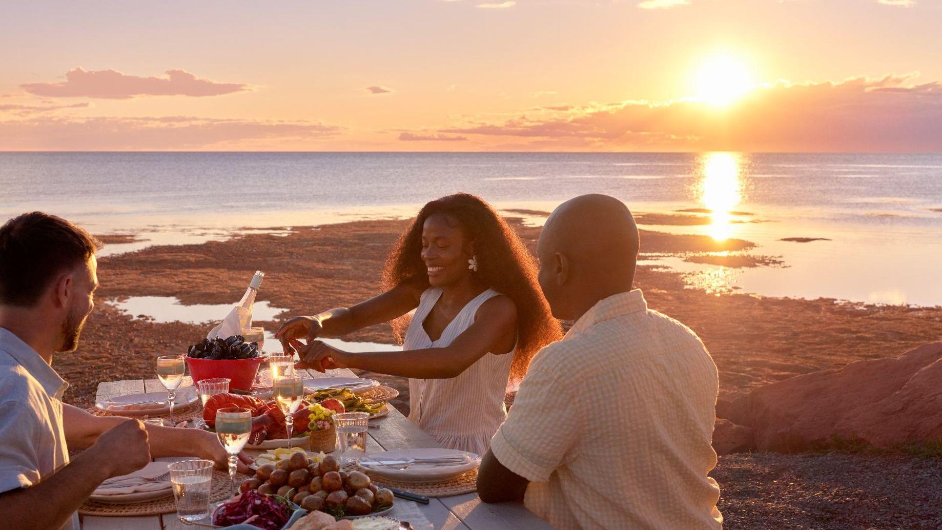
15 Second Spots

Slide 22


Slide 23
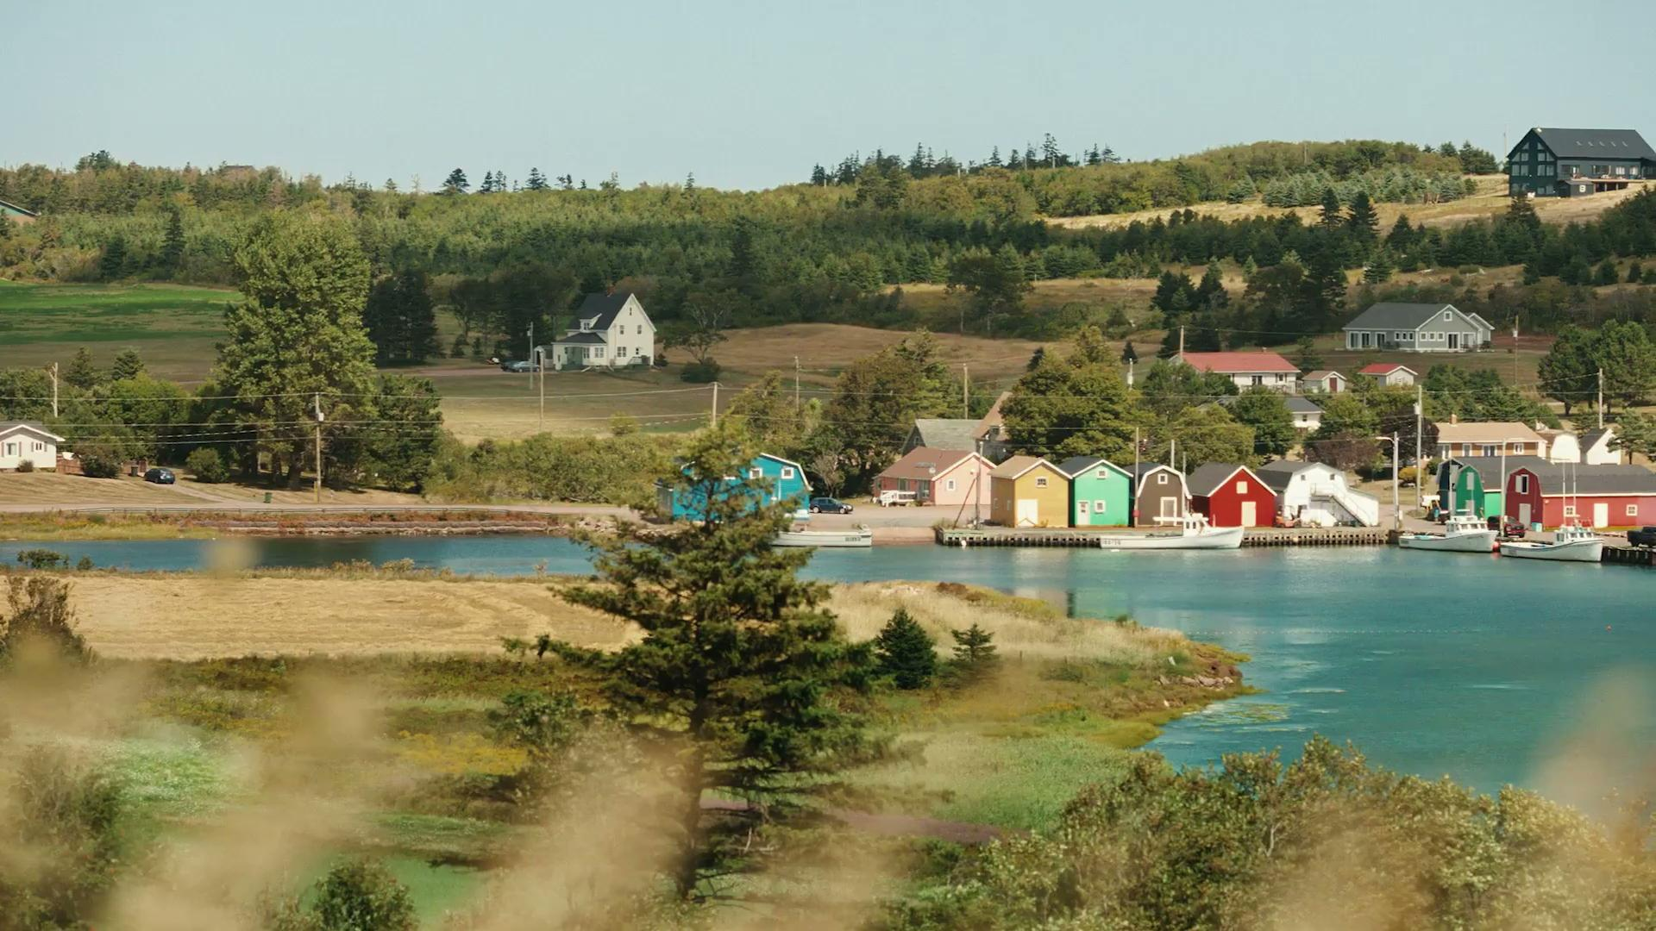


Slide 24



Slide 25
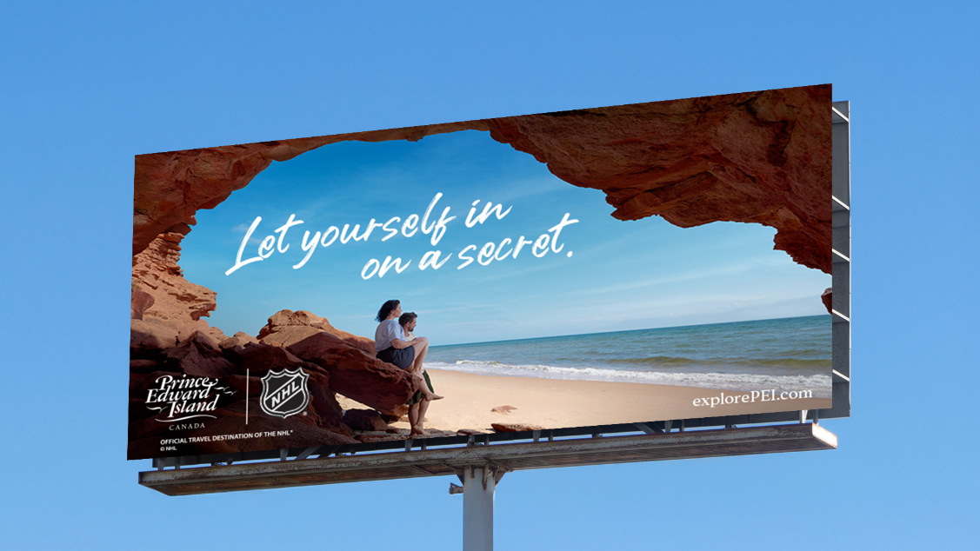
Out-of-Home

Slide 26
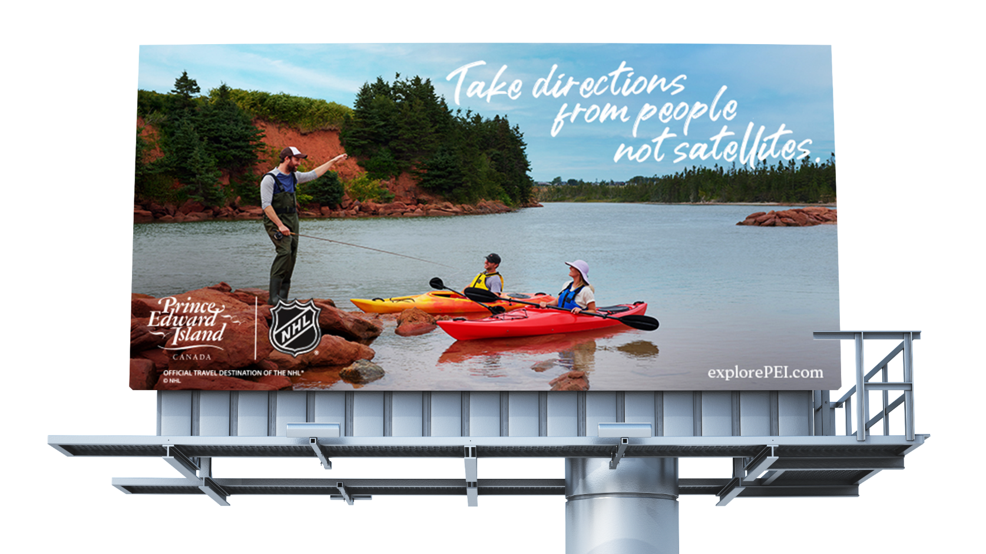

Slide 27
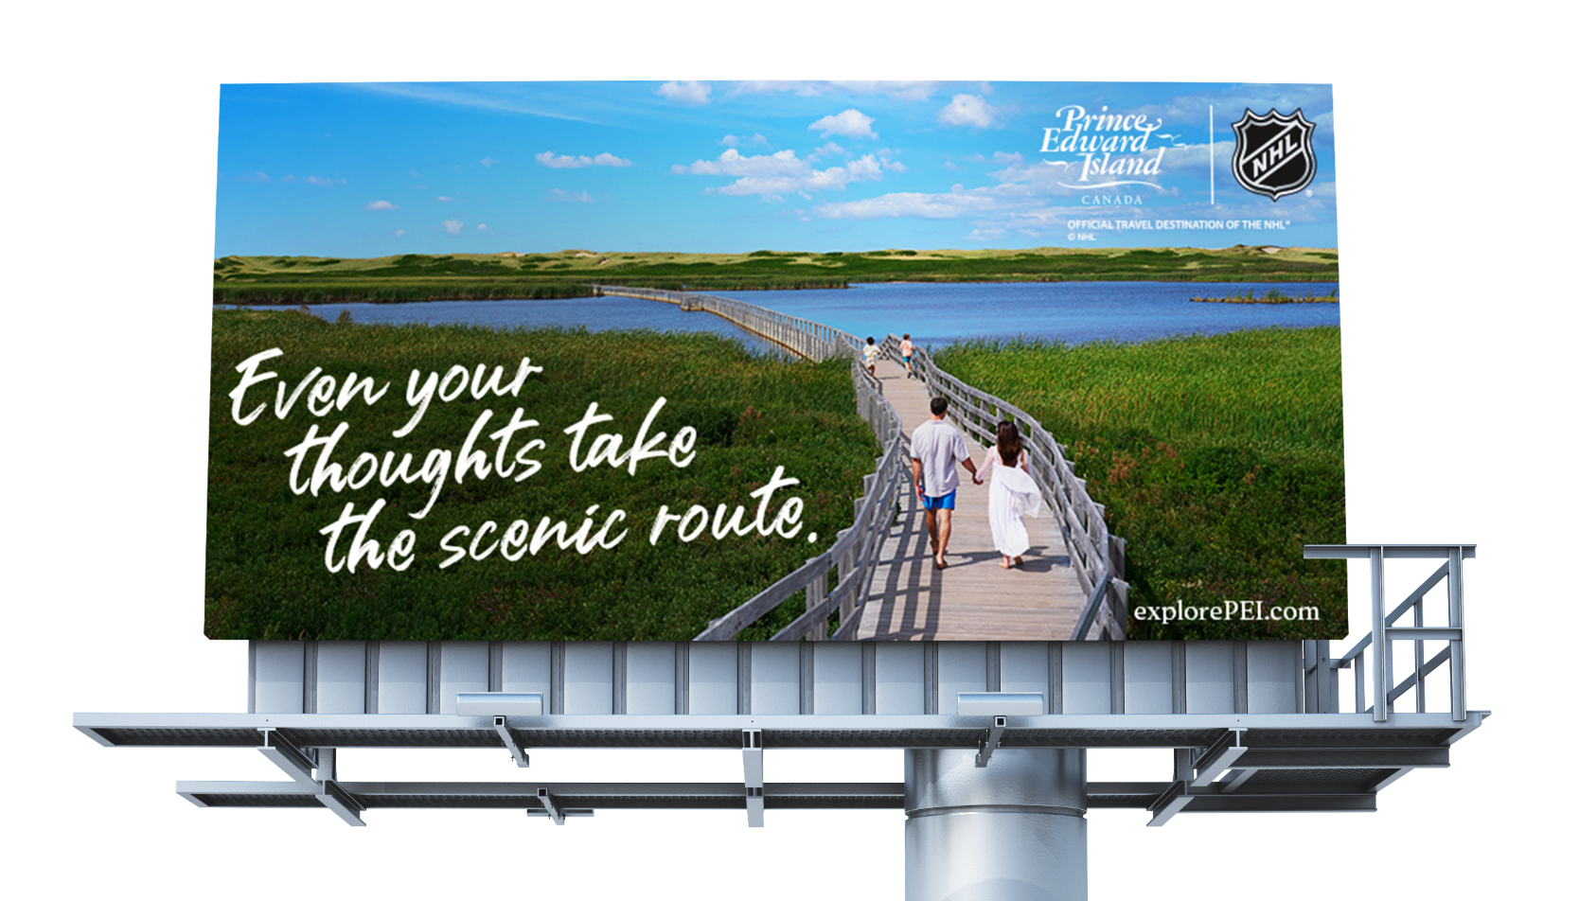

Slide 28
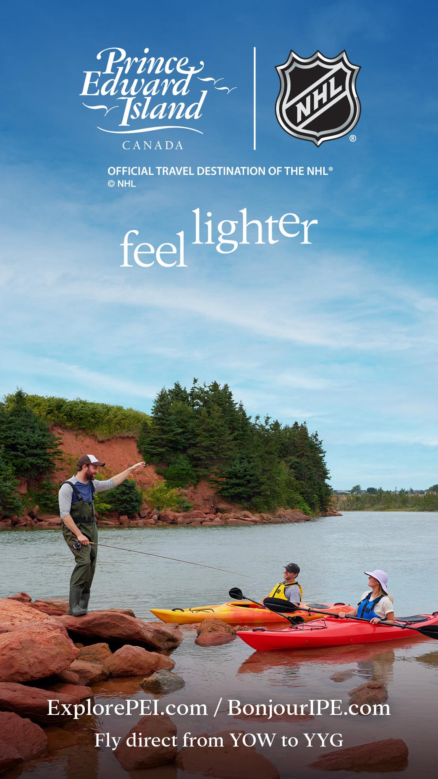
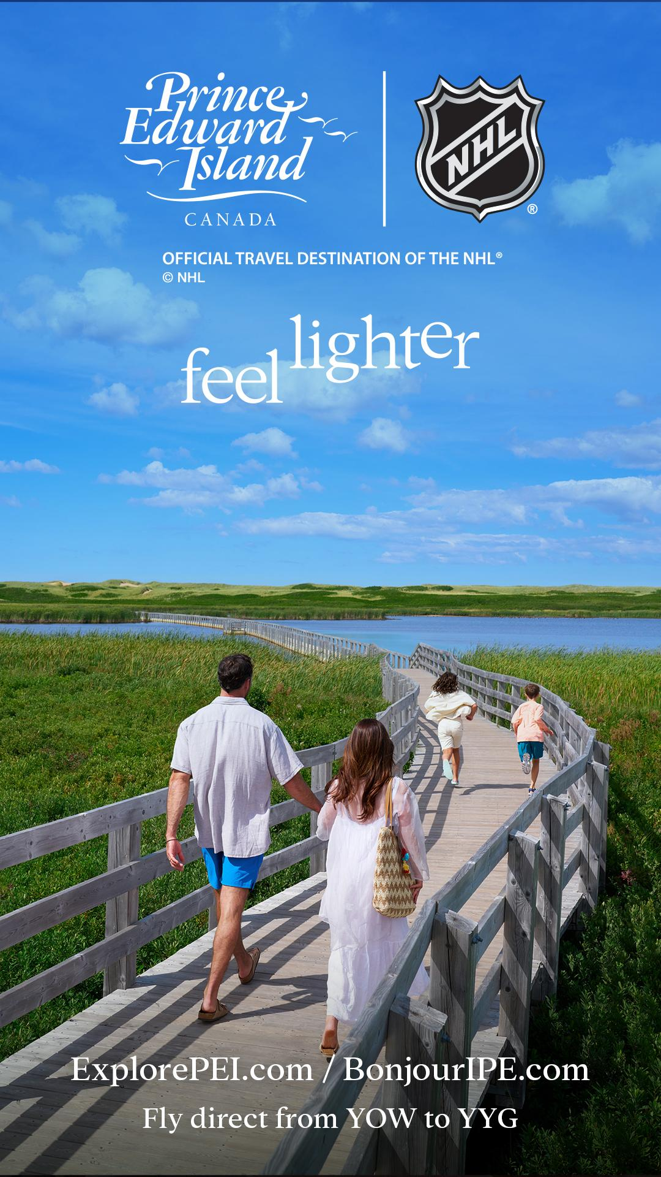
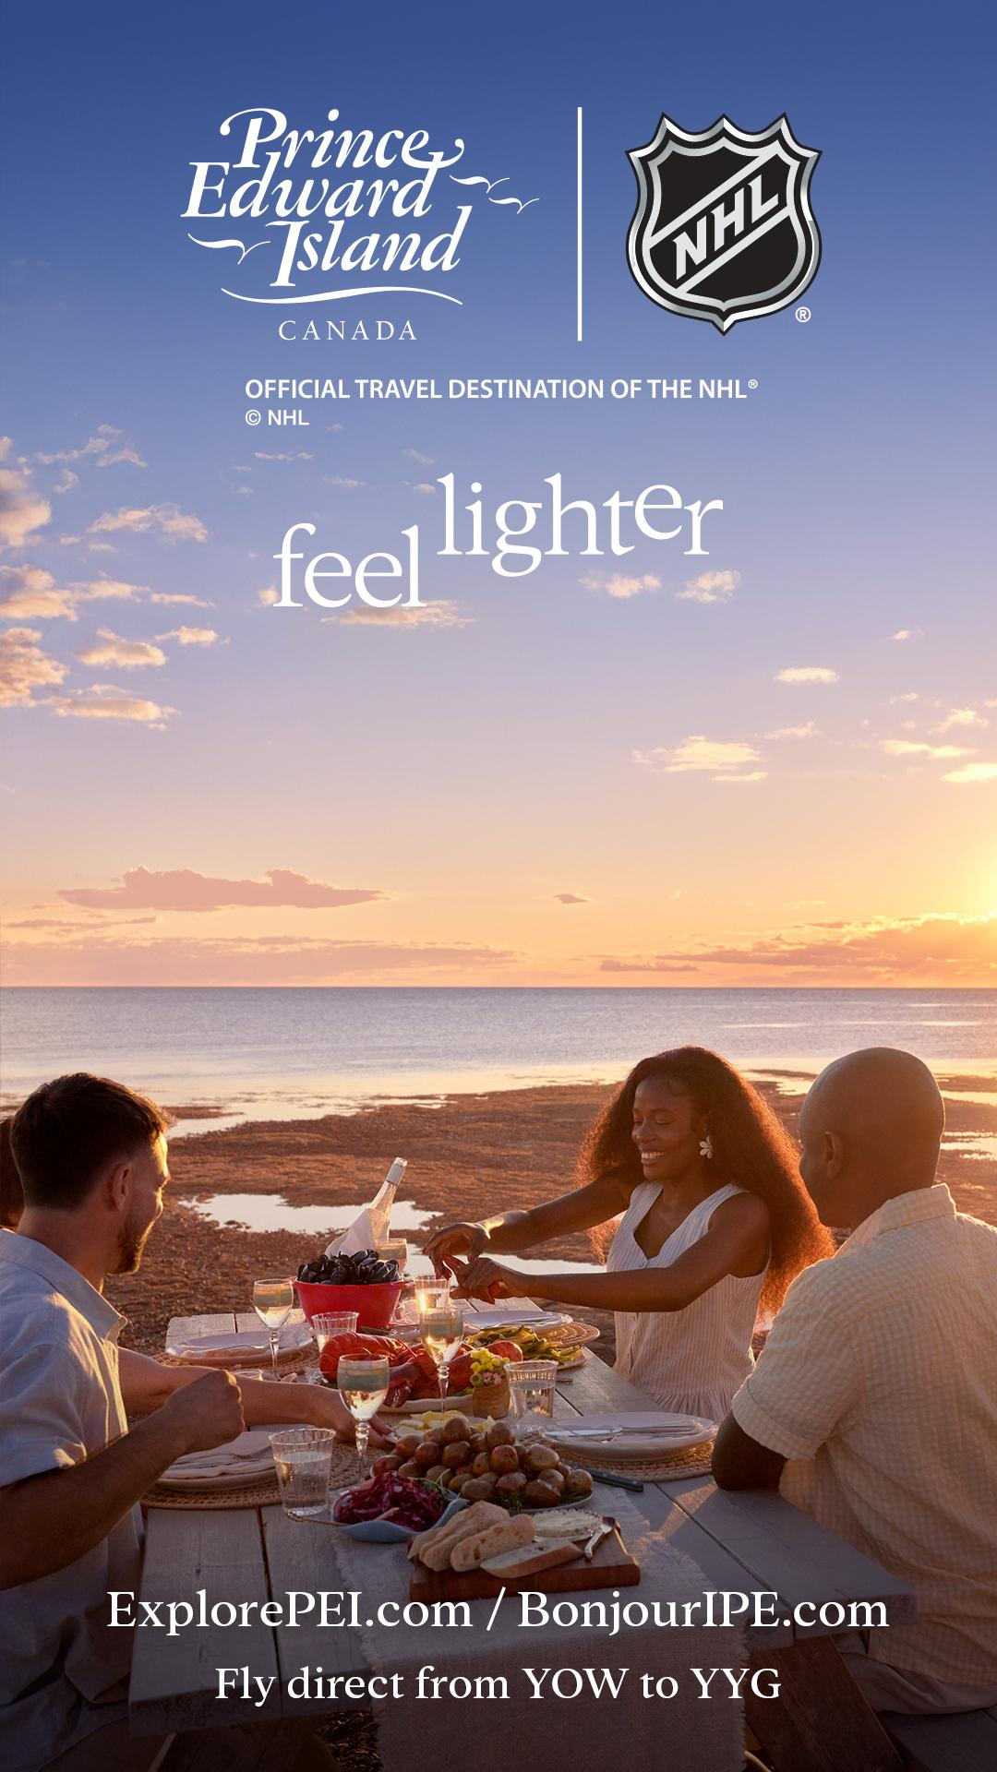

Airport Digital Signage

Slide 29
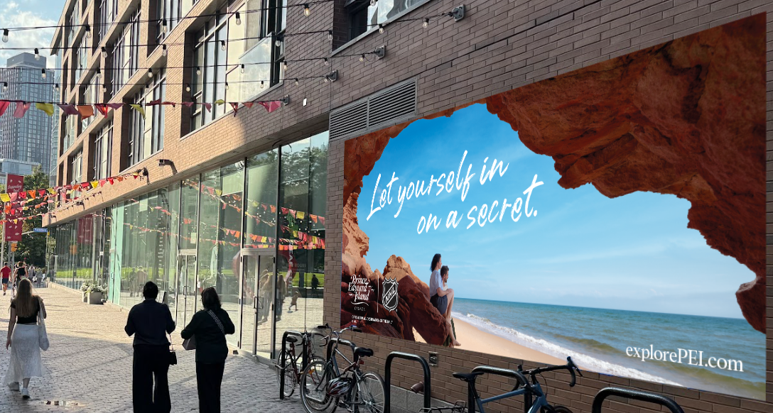
Distillery District Mural

Slide 30
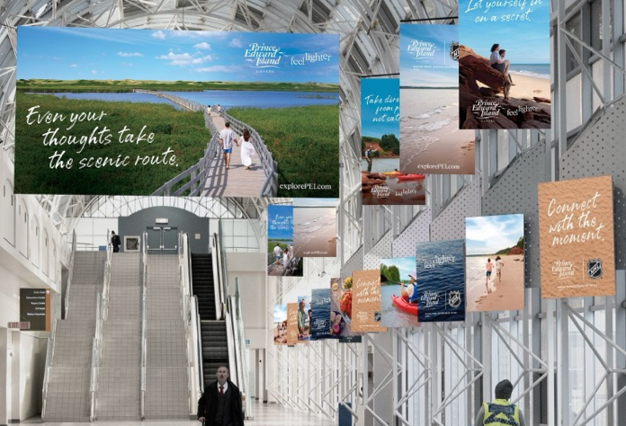
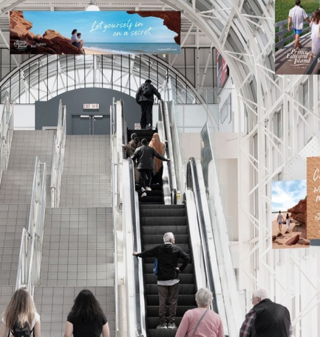
Union Station Skywalk

Slide 31
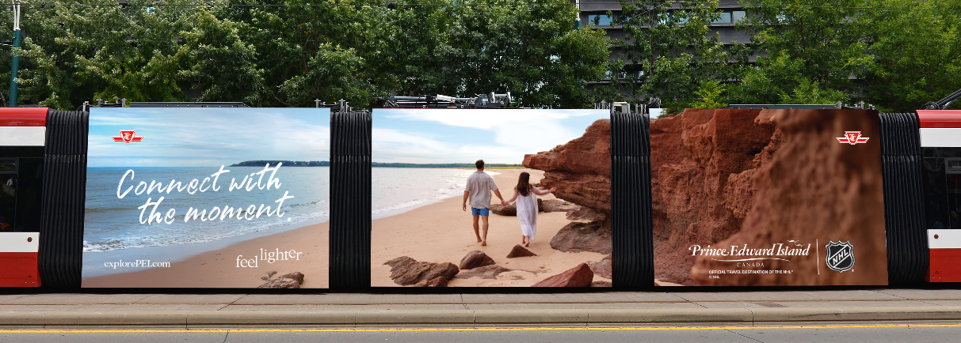
TTC Streetcar

Slide 32
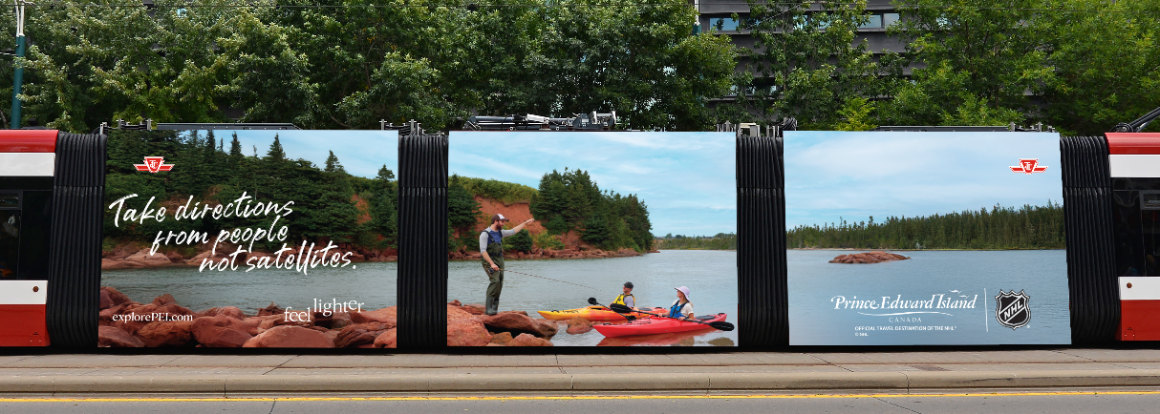
TTC Streetcar

Slide 33
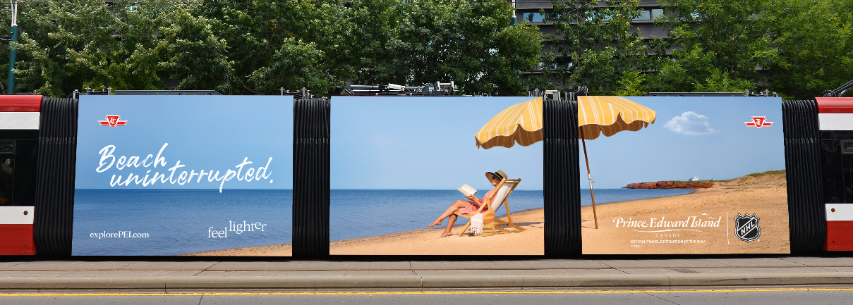
TTC Streetcar

Slide 34
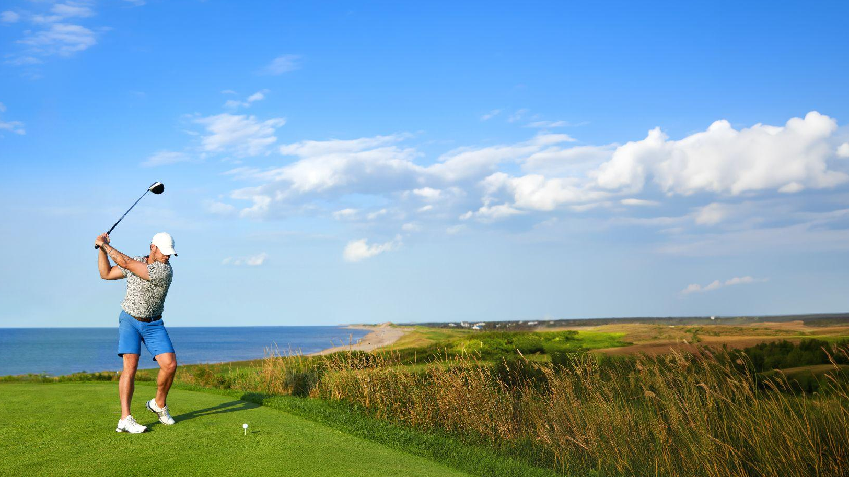
NHL Creative
2026

Slide 35


Slide 36
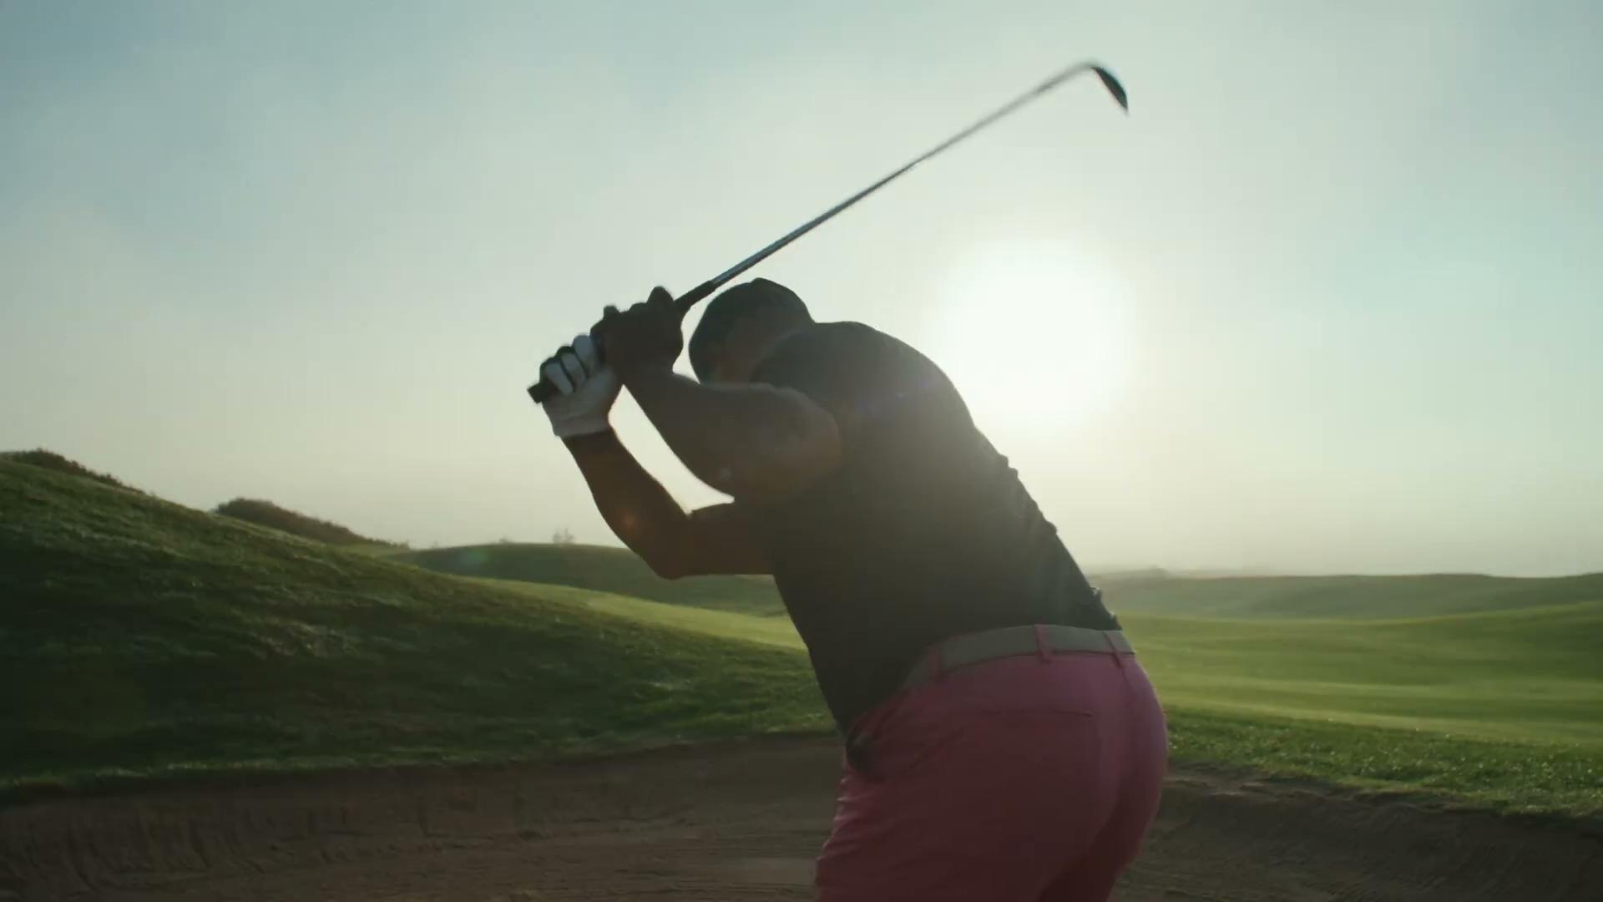

Slide 37
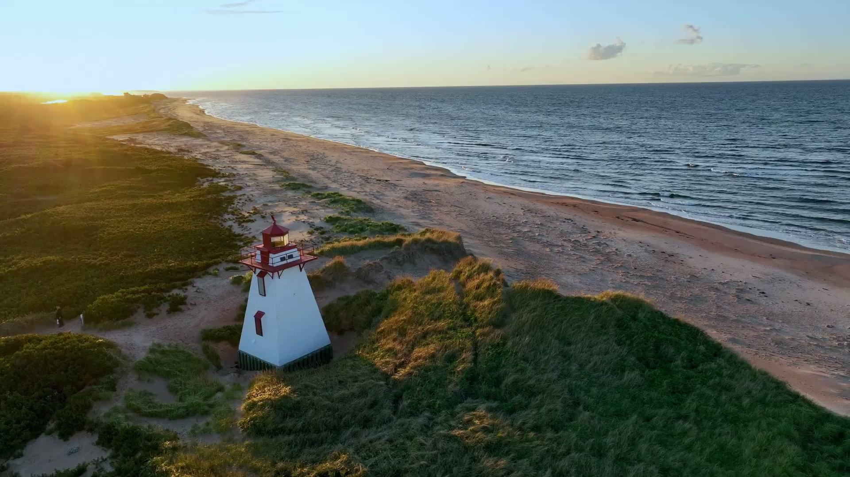

Slide 38
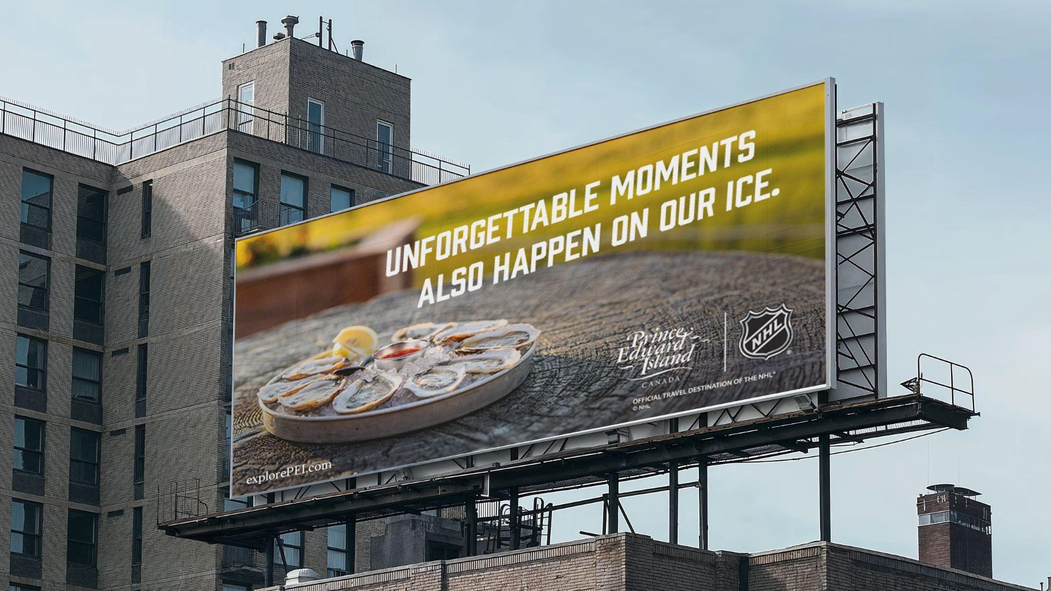
Out-of-Home

Slide 39
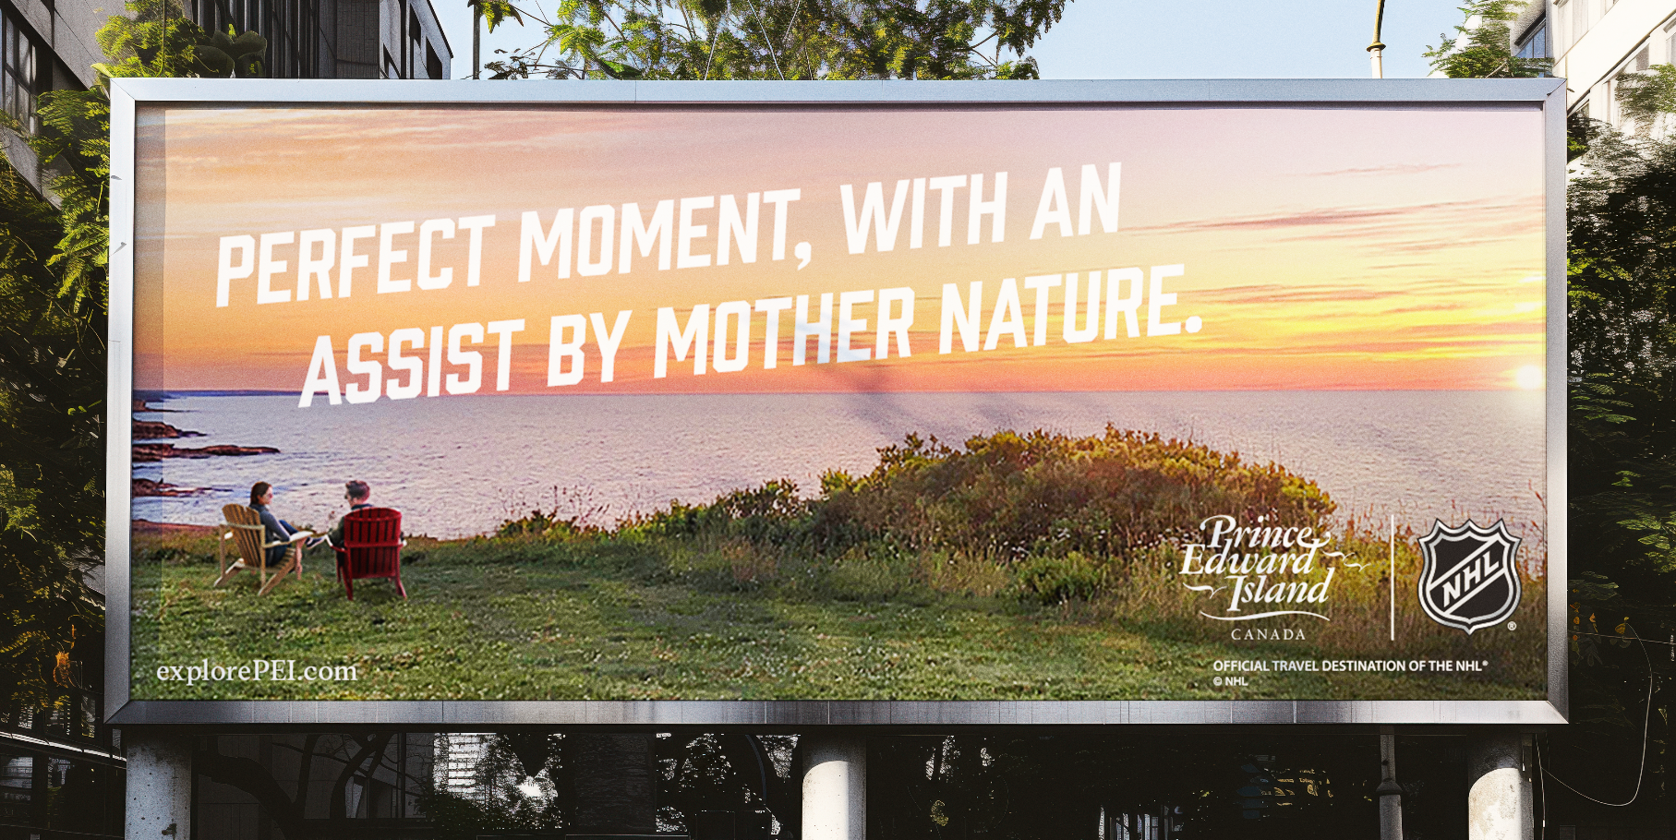

Slide 40
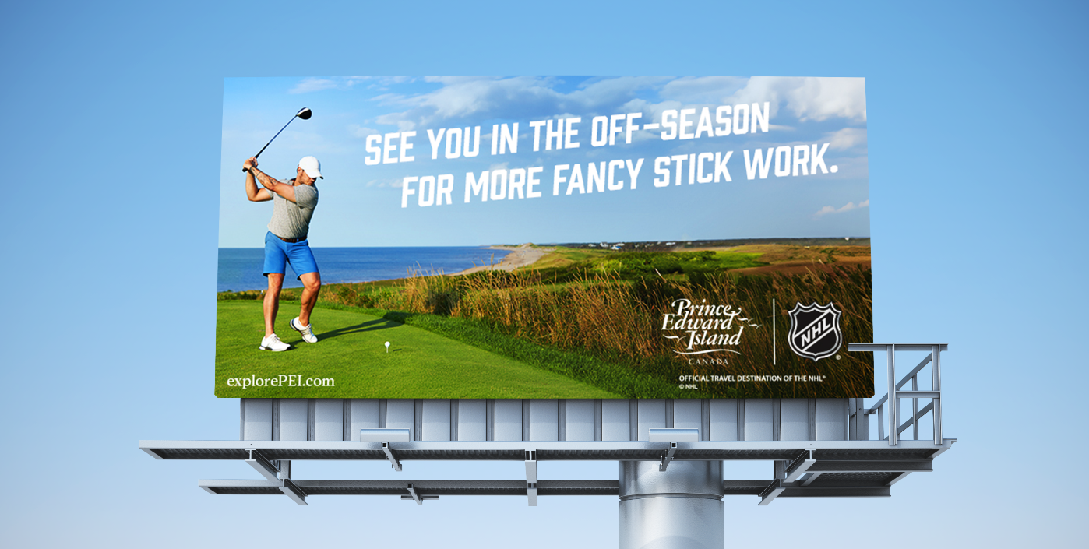

Slide 41
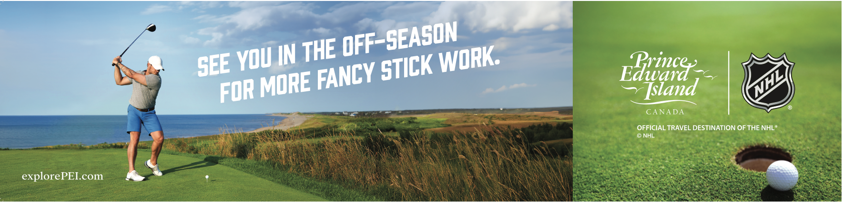
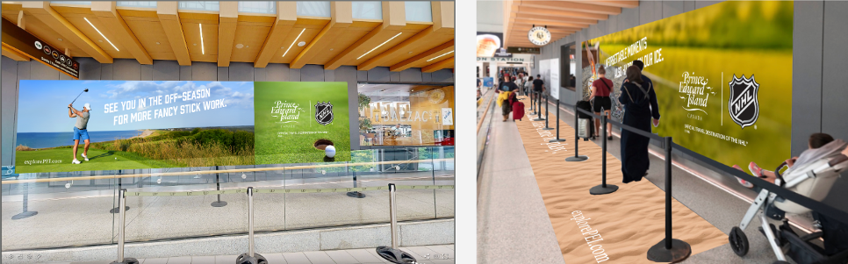
UP Express Takeover

Slide 42
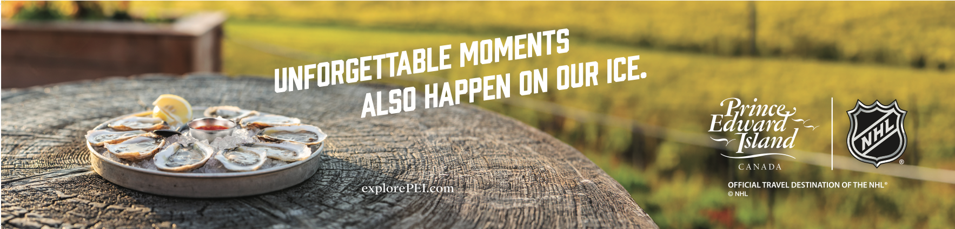
UP Express Takeover

Slide 43
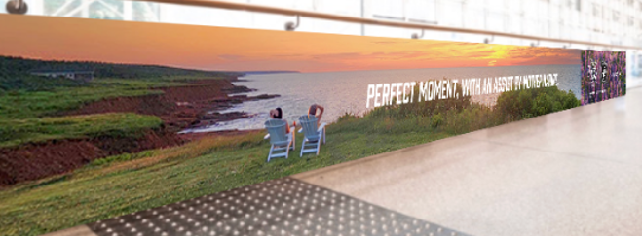
UP Express Takeover

Slide 44
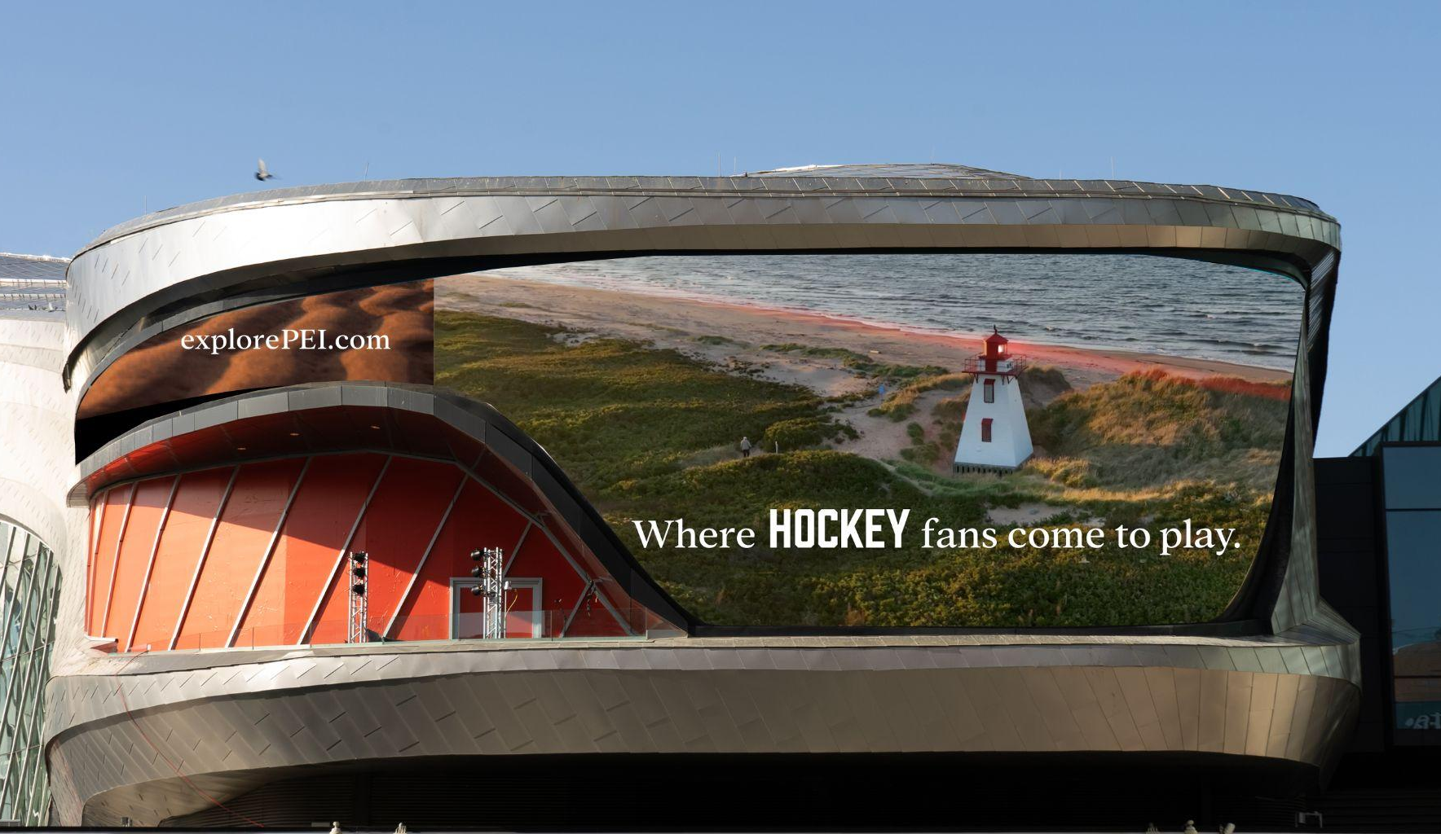
Edmonton Ice District

Slide 45
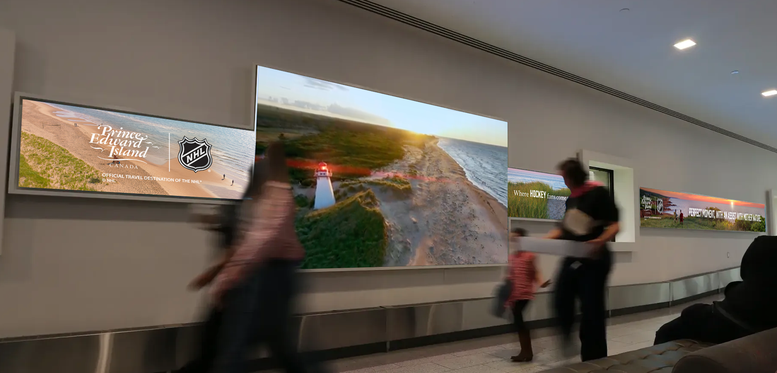
Calgary Pathway

Slide 46
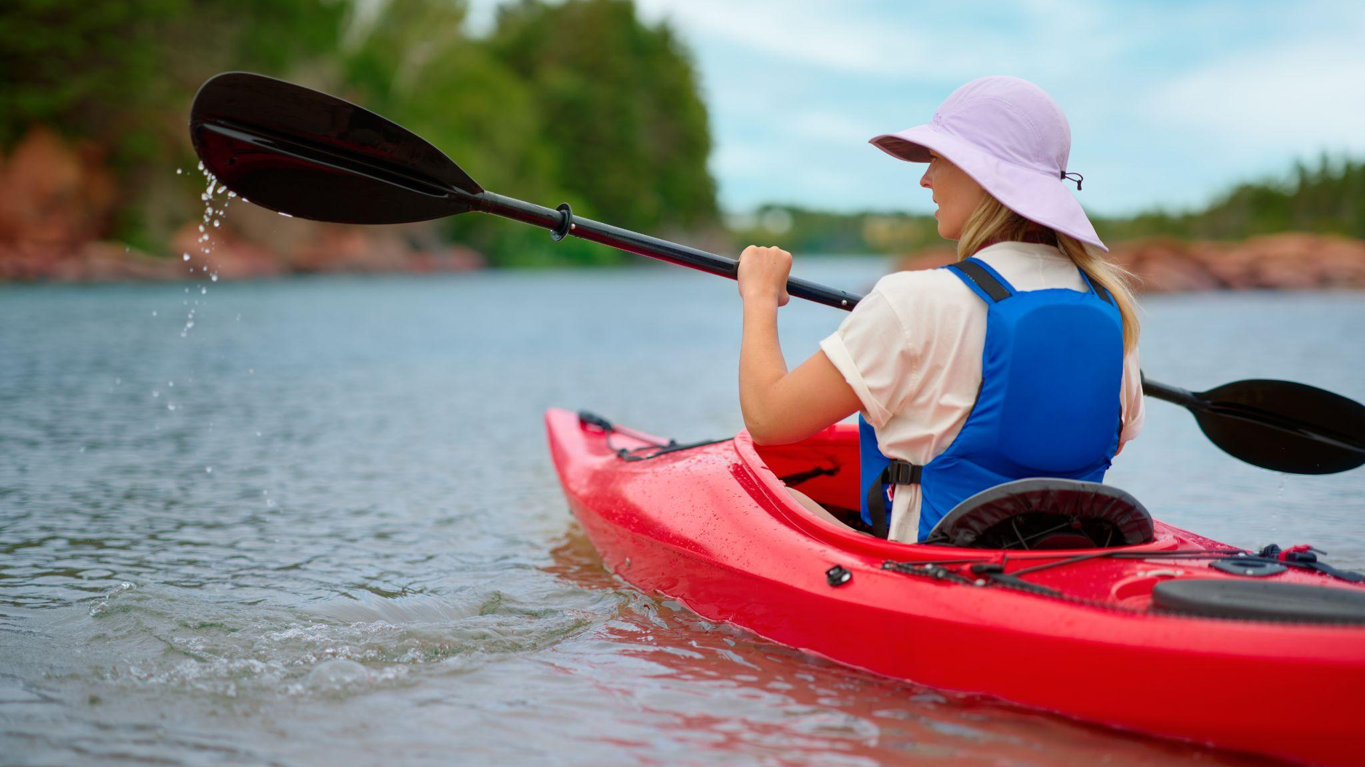
French Creative

Slide 47




Montréal Aero-Columns

Slide 48


Montréal Bixi Bike Posters

Slide 49


Québec City Digital Screens

Slide 50
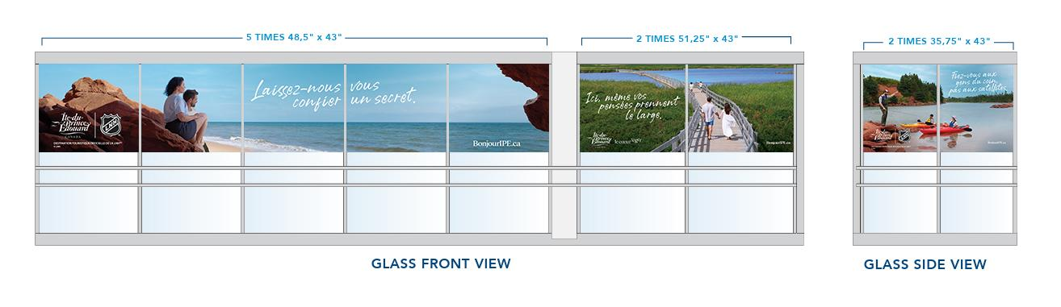
Québec City Ferry

Slide 51
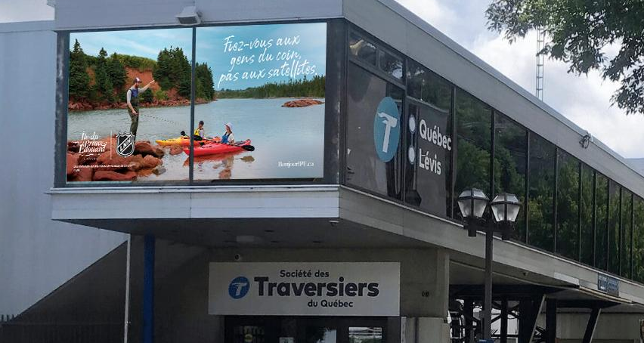
Québec City Ferry

Slide 52
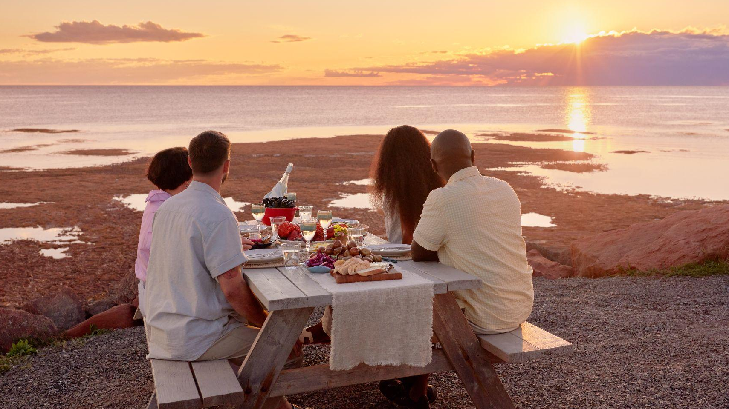
Thank you

